Slide 1
GROUP A
Scrum Master: Atharva Shah

Slide 2
Website Name
WYDRN
Category
Social Network and Entertainment Catalog
Members
Atharva Shah (Scrum Master)
Om Khulbe
Rashmi Kamble
Nikhil Haswani
Lavesh Milani
Atharva Shiurkar
Anay Deshpande

Slide 3
WYDRN
(What You Doin’ Right Now)
Project Presentation

Slide 4
Summary:
WYDRN (What You Doing Right Now?) is a Social Networking website where you can track your movies, tv, games, books and music as well as socialize with other members. Sign Up is required to use the service.
Objective and Need:
Users can log their media items (movies, tv, games, books and music) and keep a fancy looking profile to publicly showcase what they currently doing.
Browse these media items and match your interests with your friends by following them and checking out their profiles.
See a canvas/gallery view of each of your media items ((movies, tv, games, books and music)
Keep a diary of all logged items and filter by date.
Export all your user data and import it back at any point of time.
We tend to use multiple platforms to catalogue multiple media types like IMDB for Movies, Goodreads for Books, Steam for Video Games, RYM for Music and TvTime for TV. We aim to develop a service to provide a centralized platform to track all your favorite media instead of using all these services for different media items. One platform to rule them all.

Slide 5
What Purpose does this Project fulfill?
IMDB (Personal Movies Cataloging Service) - As of March 2022, the database contained some 10.1 million titles (including television episodes) and 11.5 million person records. Additionally, the site had 83 million registered users.
Trakt.TV (Personal Television Cataloging Service)- As of 2022, there are 2 Million Daily Active Users who log their TV shows and episodes daily to the platform.
Goodreads.com (Personal Book Cataloging Service) gets 45 million active visitors a month, with 100K+ books being rated daily.
Steam (Personal Videogame Library Service) has 120 million monthly active users. 62.6 million people use Steam on a daily basis. The Steam catalog in the US includes 50,361 games. Steam users logged 31.3 billion hours of playtime in 2020
RateYourMusic (Personal Music Cataloging Service) currently has 662,475 active users with most users adding 5-10 albums to their account per week.
Everyone loves to catalog and showcase their taste so why not provide a centralized platform that supports ALL 5 types of medias to the users. WYDRN is not simply JUST A CATALOGING SITE. It is a dual-nature modern platform that also supports social networking and allowing users to see their matching tastes with other users through our standout feature we have dubbed as “Mutual View”.
Additionally to cataloging, users can also view their diary, statistics, earn badges as achievements, browse media, follow other users and Import and Export their data as required.
WYDRN is an API-driven, ambitious, modern and sweet-looking platform for all the entertainment junkies.

Slide 6
Technical Details
Tech Stack
HTML5
CSS3
JavaScript ES6
PHP v8.1
MySQL v8.0.26
Bootstrap CSS v5.20
JQuery v3.4
Python v3.10 (Only for Recommendation Models)
System Specifications
Developed on: Windows 10 OS
Tested on: Google Chrome/Brave (or any Chromium Browser v105) with a 1080x1920 screen.
Raw Folder Size: ~1.2GB (including all assets and source files)

Slide 7
References
This project would not have been possible without the glory of the internet forums, the developer community and numerous Youtube tutorials. As a Scrum Master, I have recorded the most useful blog posts and front-end resources that we have looked into during the development phase.
Here is the complete list:
HTML Email Formatting- https://css-tricks.com/sending-nice-html-email-with-php/
How to Make Responsive Website- https://www.browserstack.com/guide/how-to-create-responsive-website
FPDF docs- http://www.fpdf.org/en/doc/index.php
PHP Emails https://www.geeksforgeeks.org/how-to-send-an-email-using-phpmailer/
PDF Generation and Table Styling http://www.fpdf.org/en/script/script14.php
404 Pages To Check Out- https://www.searchenginejournal.com/404-page-examples/211154/
Deployment Guide- https://www.google.com/amp/s/auth0.com/blog/amp/the-ultimate-guide-to-deploying-php-applications/
Troubleshooting: Google Books Low Quality Covers- https://stackoverflow.com/questions/65562340/high-quality-book-covers-using-google-books-api

Slide 8
GIT Undo- https://stackoverflow.com/questions/1616957/how-do-you-roll-back-reset-a-git-repository-to-a-particular-commit
Sweet Alerts - Used on Login, SignUp and Welcome pages- https://sweetalert.js.org/guides/#getting-started
Writing Test Cases- https://www.guru99.com/test-case.html
Dialog Box Open - https://codepen.io/highnessatharva/pen/KKoGdvO
Glowing Social Icons - https://codepen.io/highnessatharva/pen/OJvwZNy
Responsive HTML Table - https://codepen.io/highnessatharva/pen/KKooRLj
AutoSorting HTML Table - https://codepen.io/highnessatharva/details/KKoJoPv
Sliding Social Feed - https://codepen.io/seyedi/pen/zYoeLEv
Edit Profile Page Styling - https://codepen.io/fat_64/pen/YzPeNwR
Landing Page fancy animation #1 - https://tympanus.net/Tutorials/ImageGridMotionEffect/
Landing Page fancy animation #2 - https://tympanus.net/Development/RapidLayersAnimation/
Carousel Animation (Use for features/media showcase - https://nickpiscitelli.github.io/Glider.js/
Cursor Tracker - https://tympanus.net/Tutorials/codrops-masked-hero/
Bootstrap UI Components and Theme Kits - https://mdbootstrap.com/
UI Kit for Admin page - https://mdbootstrap.com/docs/standard/design-blocks/admin/

Slide 9
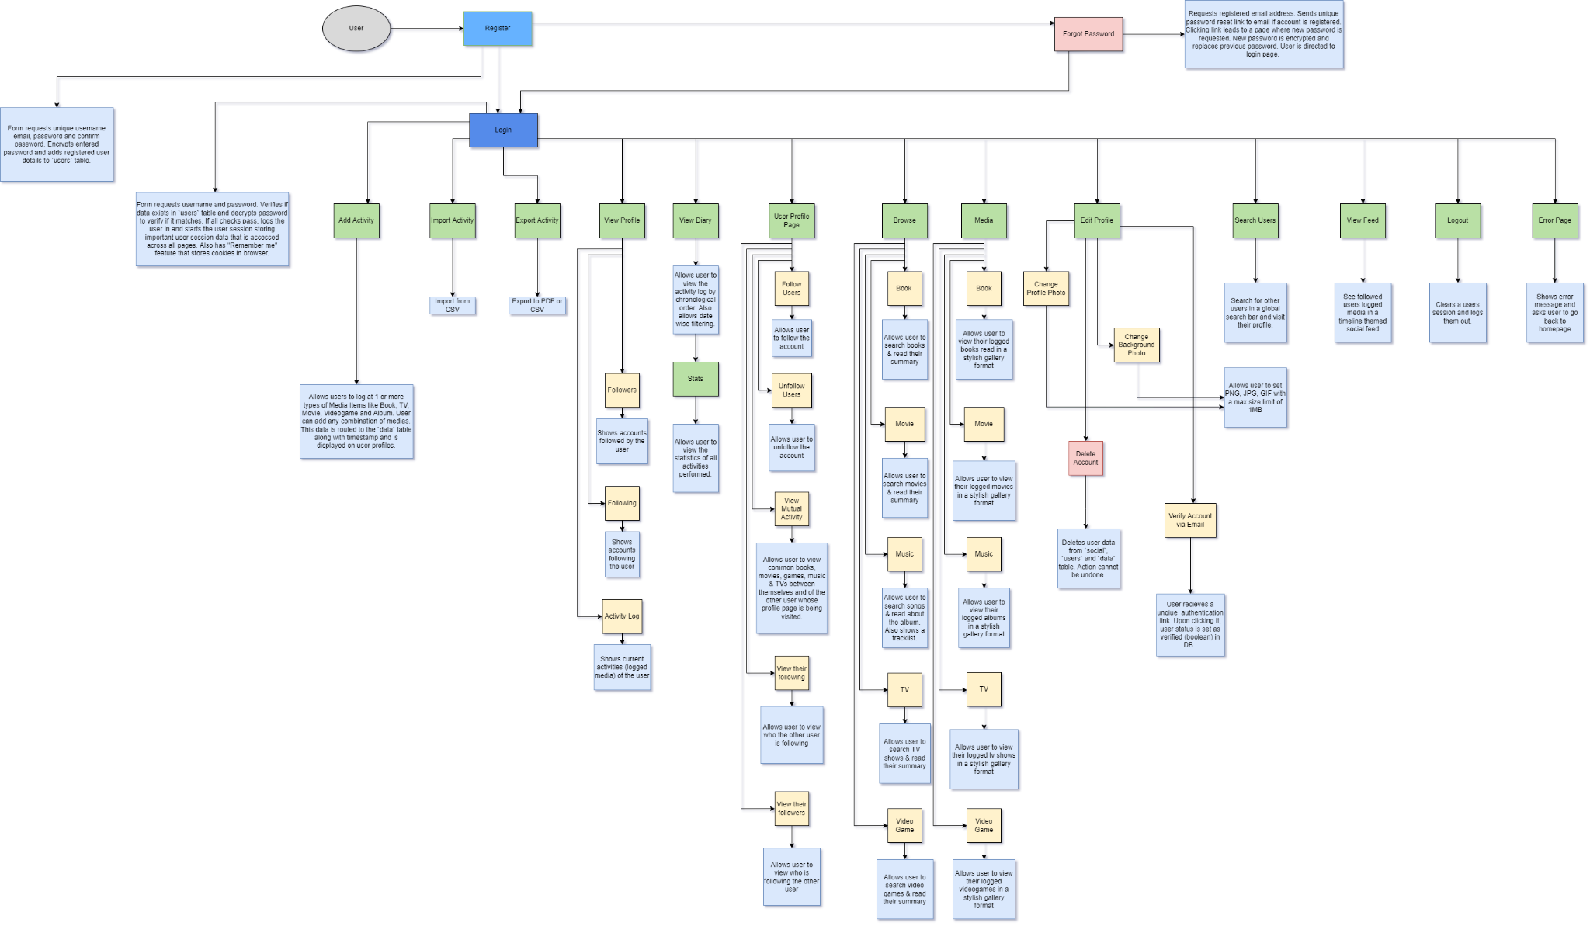
Diagrams
User Walkthrough/Flow Diagram

Slide 10
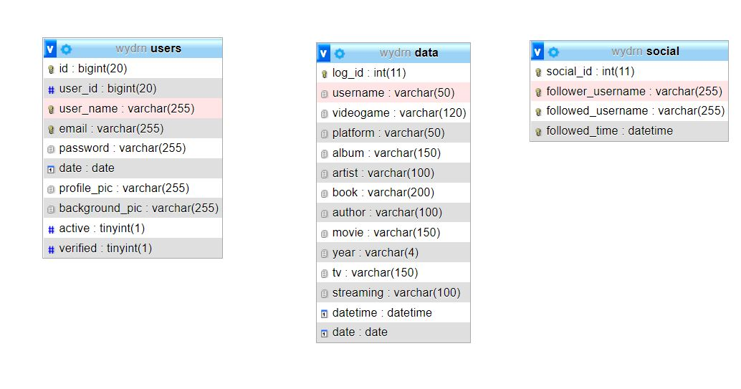
Diagrams
Database Schema Diagram (ERD)

Slide 11
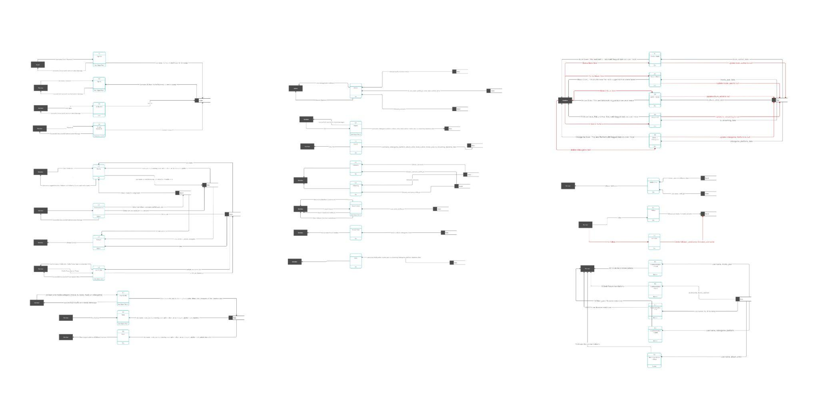
Diagrams
Data Flow Diagram (DFD)

Slide 12
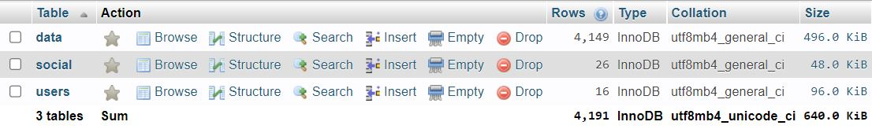
Database - WYDRN
Database has 3 tables

Slide 13
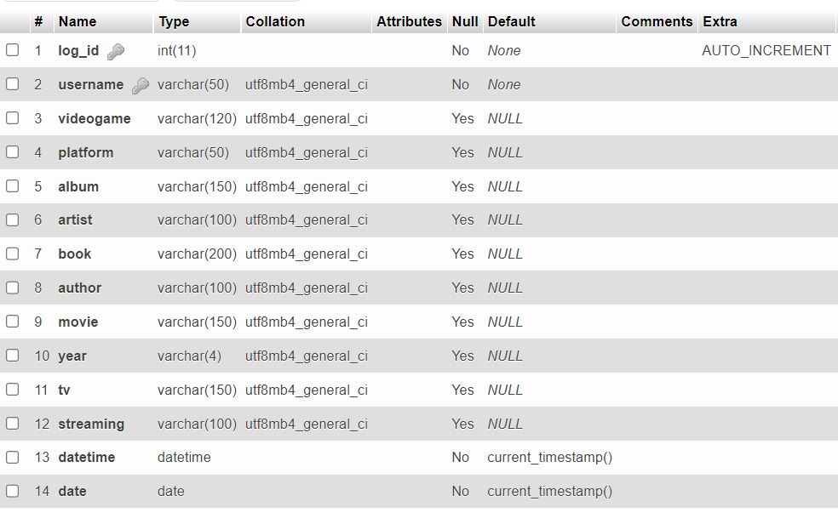
Database - WYDRN
Table #1 : “data” - all media item data along with the date of logging is filed under this table. For a record to be inserted at least one media item should be added by the user. When profile is cleared a blank row is added into the database.

Slide 14
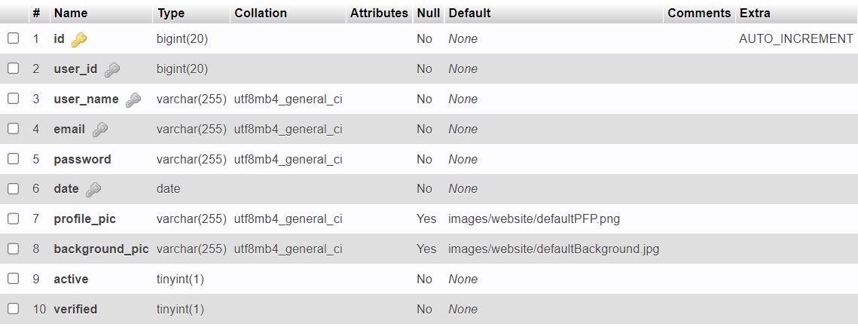
Database - WYDRN
Table #2: “users” - user registration and profile data is filed under this table. Used heavily during signup, login, edit profile and other such features. Password is encrypted using B_CRYPT() algorithm which is much more safer than the standard md5. Session variables are generated using data from this table.
#SESSION[‘user_id’] & #SESSION[‘user_name]

Slide 15
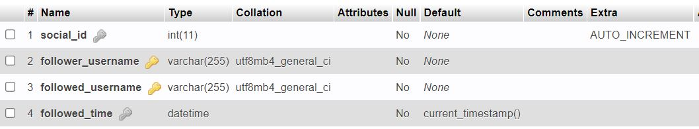
Database - WYDRN
Table #3: “social” - Social Networking relationship is filed under this table along with the followed time. This is used in feed, following, followers and back-end logic related to social media features for the website.

Slide 16
Project Hierarchy and File List
Admin.php
badges.php
clear.php*
connection.php*#
delete_user_confirm.php*
delete_item.php
diary.php
edit_profile.php
feed.php
follow.php*
followers.php
following.php
functions.php*#
header.php#
home.php
login.php
logout.php
media_book.php
media_list_view.php
media_movie.php
media_music.php
media_tv.php
media_videogame.php
Mutual_view.php
notifications.php
privacy_policy.php
profile.php
reset_pass.php
search_users.php
search_users_ajax.php*
send_reset_link.php
stats.php
submit_new.php*
verify.php*
welcome.php
WYDRN.php*
--------About--------
index.php
--------ErrorPages--------
404.html
—------Recommendation ML—----
RecommendationML/index.php
RecommendationML/header.php#
--------Exports--------
Exports/csv_export.php
Exports/csv_import.php
Exports/download_csv.php*
Exports/header.php#
Exports/import_export.php
Exports/pdf.php
--------MediaAPIs--------
MediaAPIs/Book/index.php
MediaAPIs/Movie/index.php
MediaAPIs/TV/index.php
MediaAPIs/Vidoegames/index.php
MediaAPIs/Album/index.php
MediaAPIs/header.php#
--------SearchBoxAPIs--------
SearchBoxAPIs/Book/index.html
SearchBoxAPIs/Movie/index.html
SearchBoxAPIs/TV/index.html
SearchBoxAPIs/Videogames/index.html
SearchBoxAPIs/Album/index.html
* Files only perform functional tasks or execute backend logic.
# Files that are included/required in almost every webpage

Slide 17
Home.php

Slide 18
This is the static landing page for the site.
Technologies used are HTML, CSS, Bootstrap, JavaScript and Animated Media Kit for Javascript. We use grid containers to display the 6 website features the top navbar is set to display the site title, logo and the login/signup buttons with proper links. The <footer> tag is used to hold all the links to other pages such as About Us, Privacy policy,etc.
Icons powered with CSS animations, and properties like skew, transition and scale are used to set them to in order and give an animated style.
The webpage images are stored in the images folder which further has sub folder for storing images of different sections and functions of the website.

Slide 19
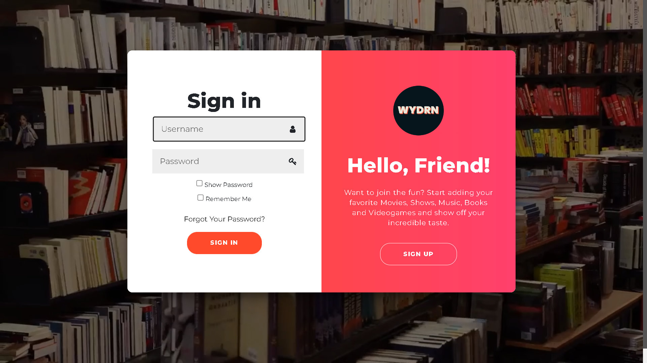
Login.php

Slide 20
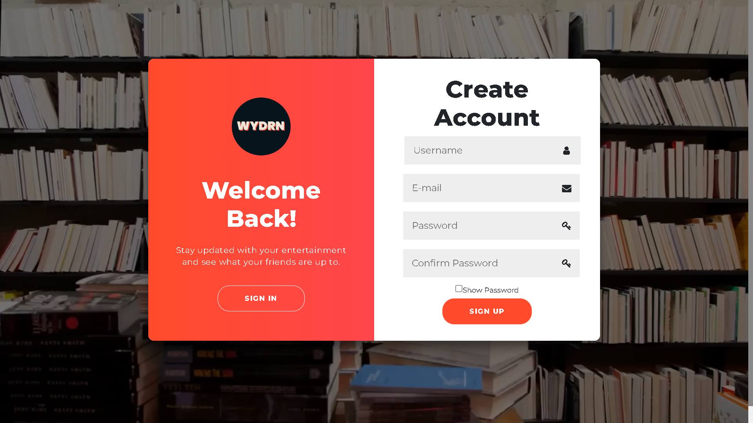

Slide 21
LOGIN SECTION
This is the Login page for the app and checks for the information provided by the user.
The page uses POST request method to send the data from the user input to the server.
It sends data to the users table in the database and checks for user_name and password in the database.
The password encryption function used is B_CRYPT() and encodes it.
The login button checks for the information and if correct redirects the user to the profile.php page.
This page makes use of cookies for auto login for the user using the remember me option.
The forgot password link redirects the user to send_reset_link.php page.
Once the user creates an account he can use the remember me function to directly login the next time he visits the website. Cookies are used to achieve this.

Slide 22
SIGNUP SECTION
This page helps the user to create/ register as a new account.
The page uses POST request method to send the data from the user input to the server.
The data is submitted to the users table in the database.
After creating the new account, the user is redirected to the login.php page to log in into his account.
SweetAlert plugin is used to display error messages
If the username is already taken an alert is displayed to the user that the username or email is already taken
Checks if the data isn’t erroneous
It also prevents the user from form resubmission when page is refreshed.
Checks if the password is more than 8 and less than 30 characters.
Checks if the entered email is a valid email.

Slide 23
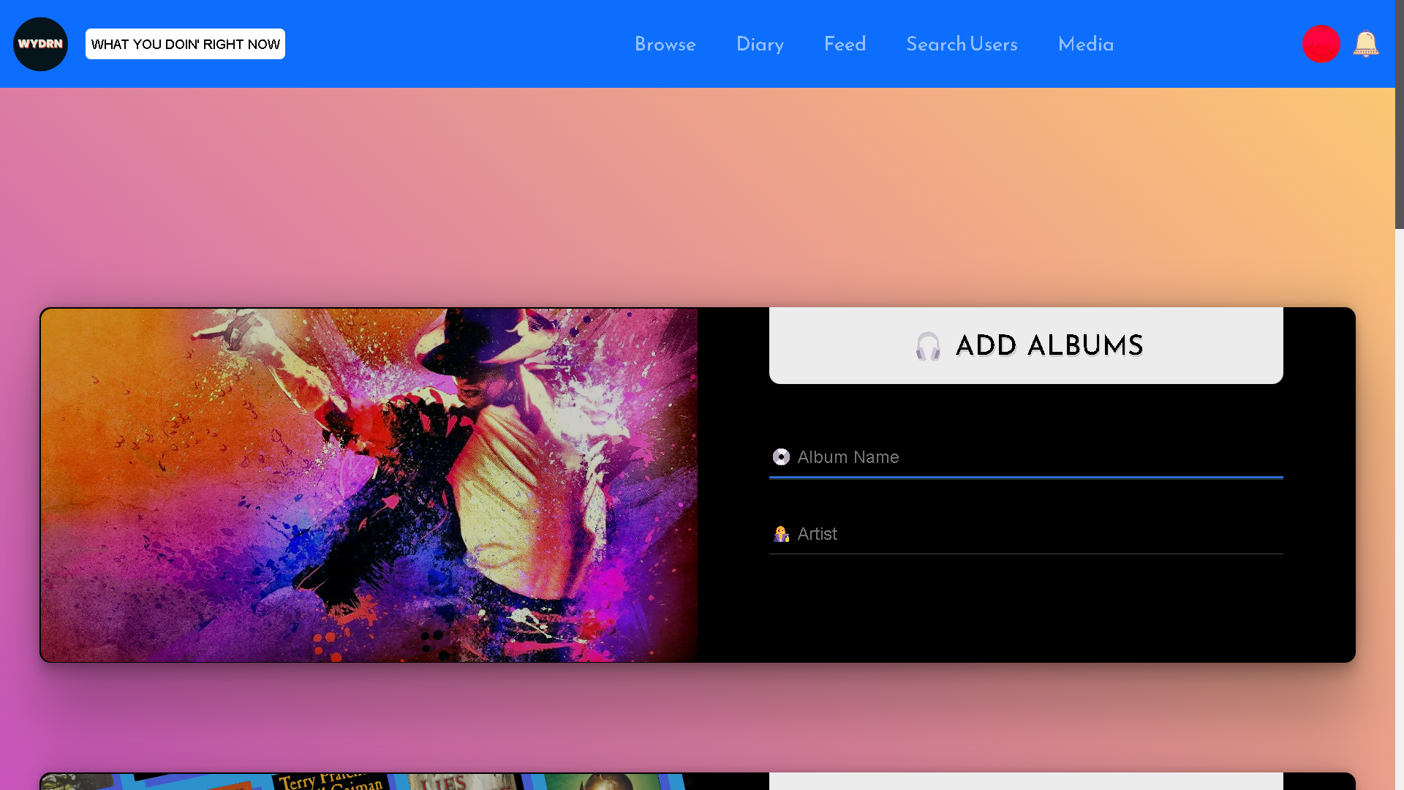
Welcome.php

Slide 24
This page is used to make an entry to the diary of the user. It allows the user to add the current music he is listening to, the current book he is reading, the current tv show/ movie he is watched, or the current video game he played.
It is mandatory to add at least 1 media to post it to the feed.
The page uses POST request method to send the data from the user input to the server.
The data is sent to the 'data' table
Music is sent to 'album' and 'artist' column in the table.
TV-Show is sent to 'tv' column and platform is sent to 'streaming' columns respectively.
Movies are sent to 'movie' column and date of release is submitted to 'year' column.
Books information is saved in 'book' column and 'author' column.
The submit button redirects user to profile.php page and saves the information and posts it to the feed.

Slide 25
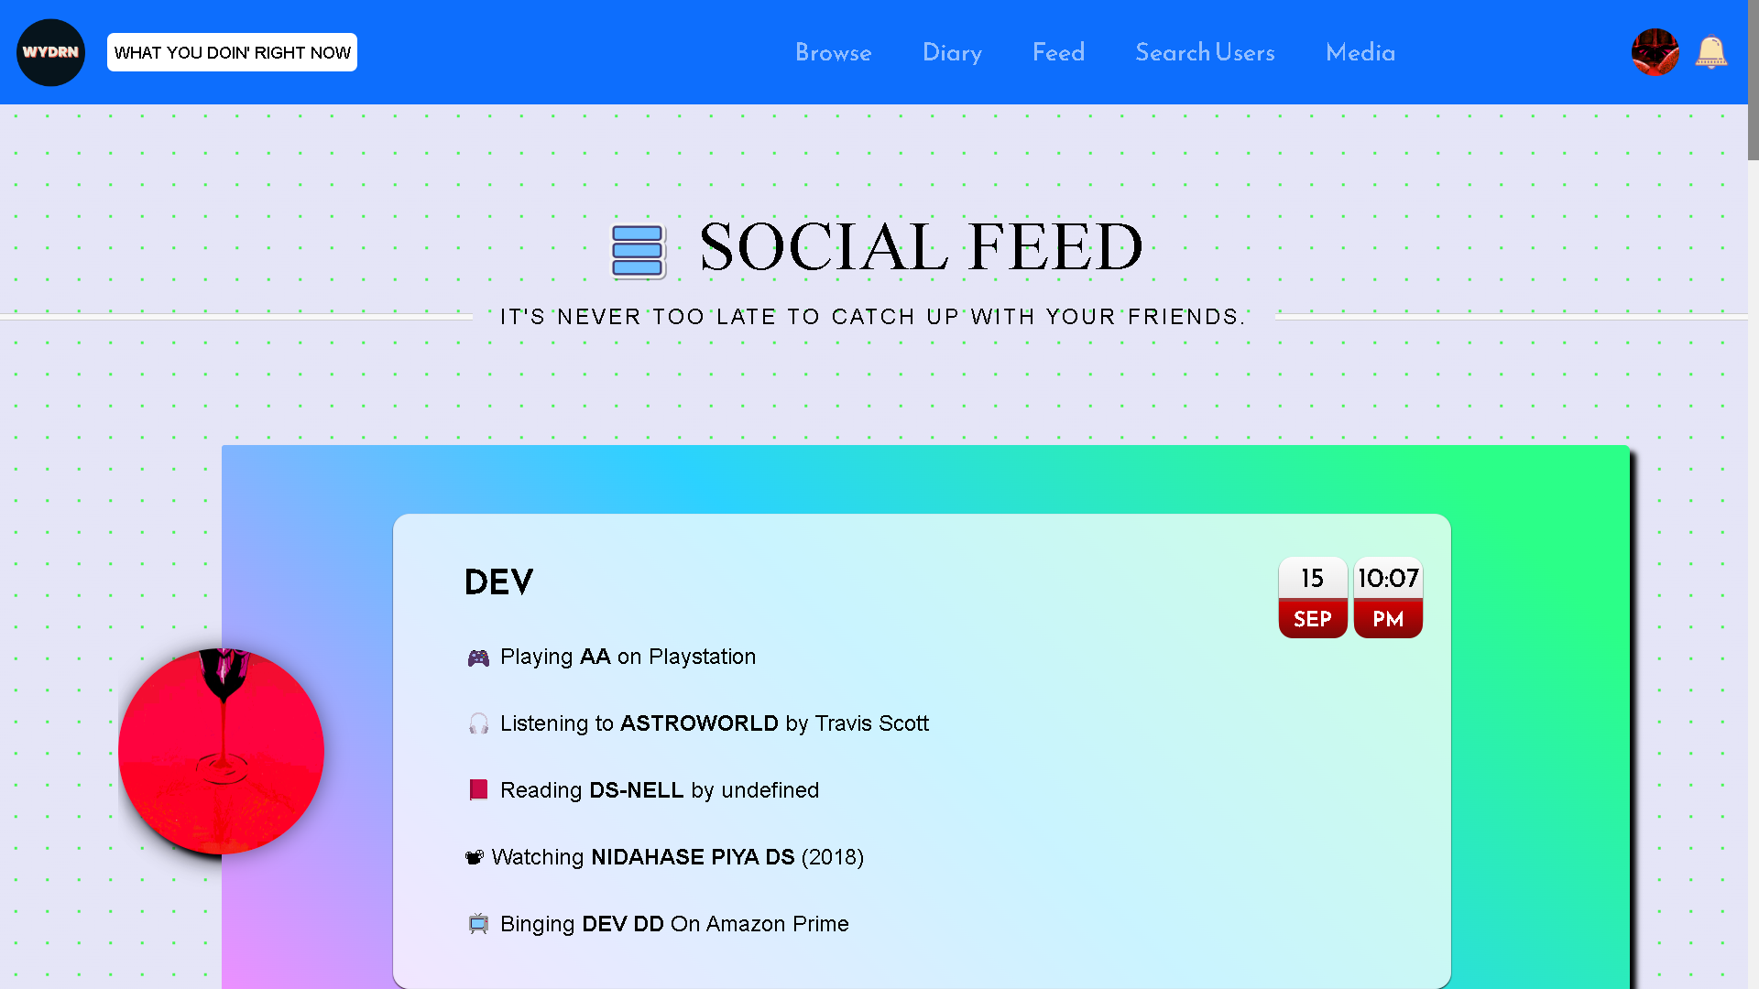
feed.php

Slide 26
DETAILS HERE
It is the social feed page where the user will see all the activities posted by members they follow.
The data is retrieved from the 'data' as well as the ‘social’ table.
“INNER JOIN” is used to join ‘data’ and ‘users’ table.
The user can click the username of any of his followed user and they will be redirected to that user’s page.
Pagination is used by implementing CSS for user’s convenience.
Each page shows 30 entries.
10 pages maximum are displayed.
Records of only those users will be selected from the database, who at least have one media item added in their profile.
strtotime() function is used to convert the database datetime object into a format that will be convenient to the user.
If the user doesn’t follow any other user then a text “YOU ARE SUCH A LONER ” is displayed.
An option below the text is available stating ‘FOLLOW MORE USERS ’, clicking on which the user is redirected to the search users page.

Slide 27
follow.php
From the profile page, users can follow/unfollow other users.
It is first verified that a user which is to be followed exists in the database,in the users table.
Following an other member adds a new row to the social table with the follower and followed username.
On the other hand unfollowing an other member deletes a row in the social table with the follower and followed username.

Slide 28
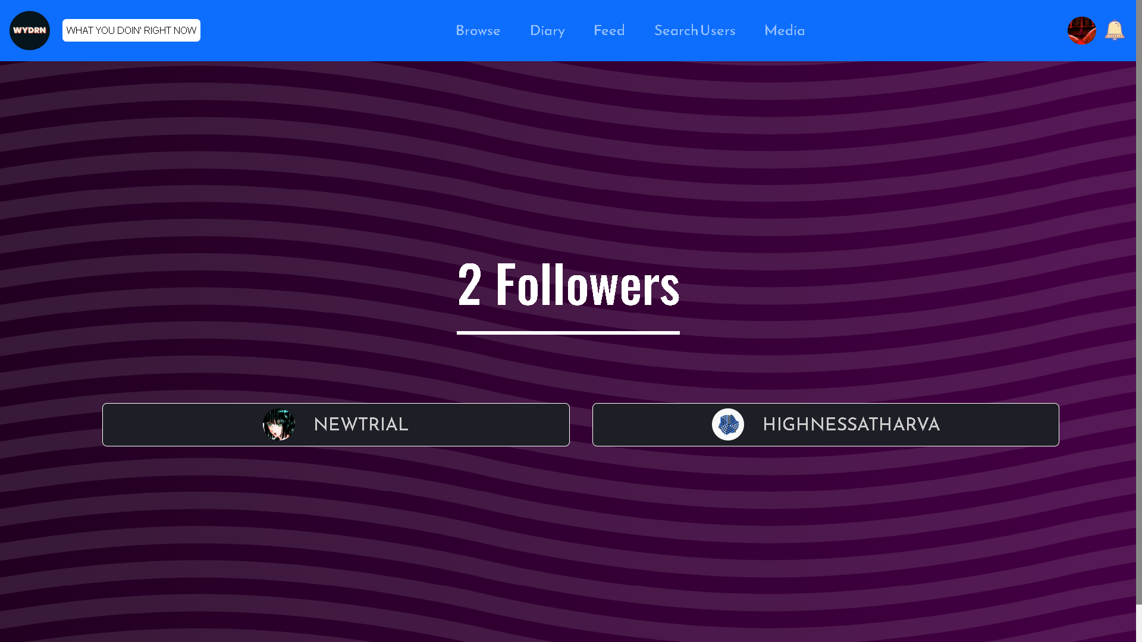
Followers.php

Slide 29
DETAILS HERE
This page shows the followers of the selected user.
The page uses GET request method to determine which user’s data is being fetched from the database, and checks if the user exists in the ‘users’ table.
‘LEFT JOIN’ keyword is used to join ‘user and the ‘social’ table, for the matching criteria which is ‘follower_username’ and ‘username’.
The @keyframe is applied for the stripes animation as a background of the page. SVG background is used.
CSS Flex is used to make the page responsive. Follower list will grow and shrink vertically as well as horizontally depending on the growing/shrinking number.

Slide 30
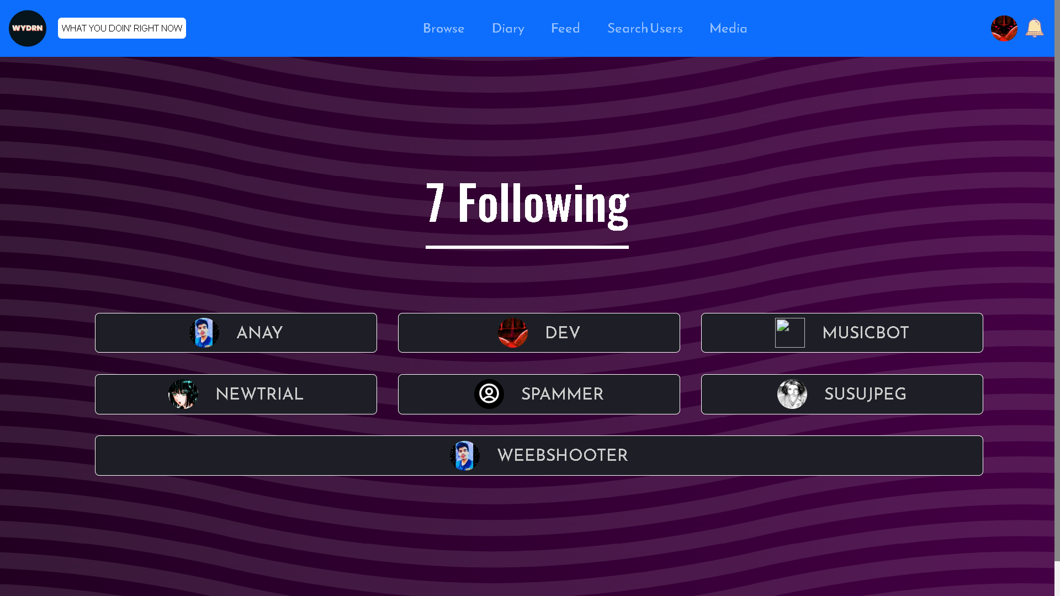
following.php

Slide 31
DETAILS HERE
This page shows the list of people that a particular user is following.
The page uses GET request method to determine which user’s data is being fetched from the database, and checks if the user exists in the ‘users’ table.
‘LEFT JOIN’ keyword is used to join ‘user and the ‘social’ table, for the matching criteria which is ‘follower_username’ and ‘username’.
The @keyframe is applied for the stripes animation as a background of the page. SVG Background is used.
CSS Flex is used to make the page responsive. Follower list will grow and shrink vertically as well as horizontally depending on the growing/shrinking number.

Slide 32
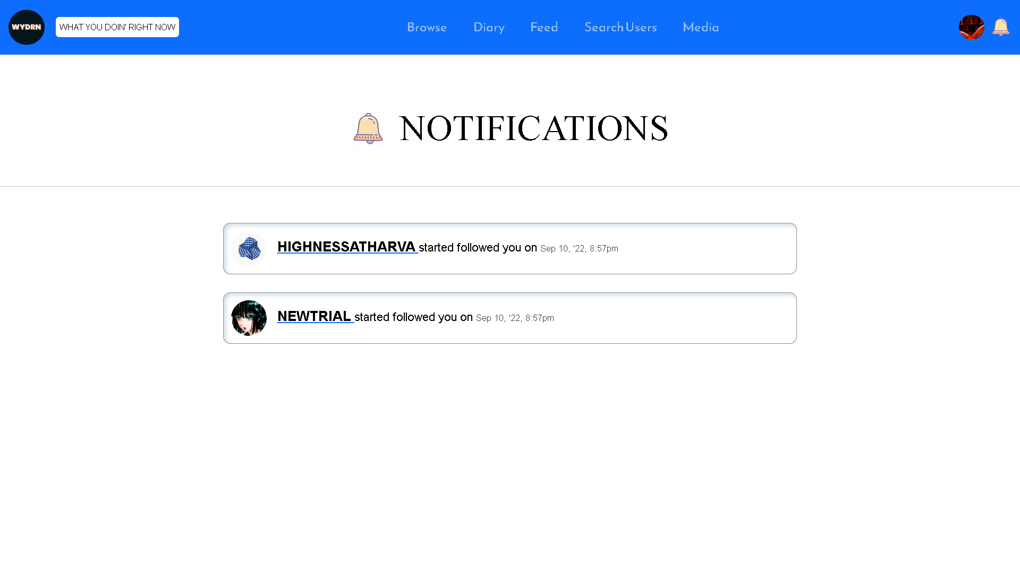
notifications.php

Slide 33
DETAILS HERE
Notifications are displayed on this page when user gets followed by other users.
Page first selects the follower username and followed time from the ‘social’ table.
Which is then displayed according to followed time in a descending order.
‘ORDER BY’ keyword and ‘DESC’ command is used to display the notifications in descending order according to the followed time.
The page also fetches the user profile pic from the ‘users’ table where the username is the follower username.
It then displays the followed time, name and profile picture of the user who followed.
“strtotime” function is used to display the followed time more conveniently for the user.

Slide 34
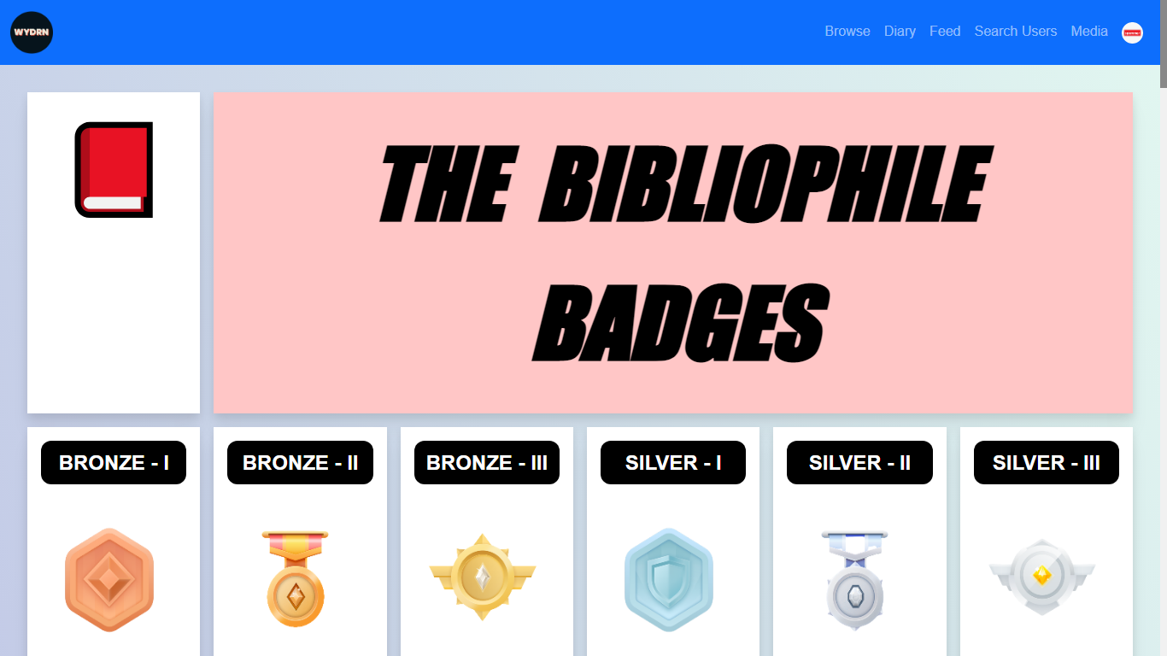
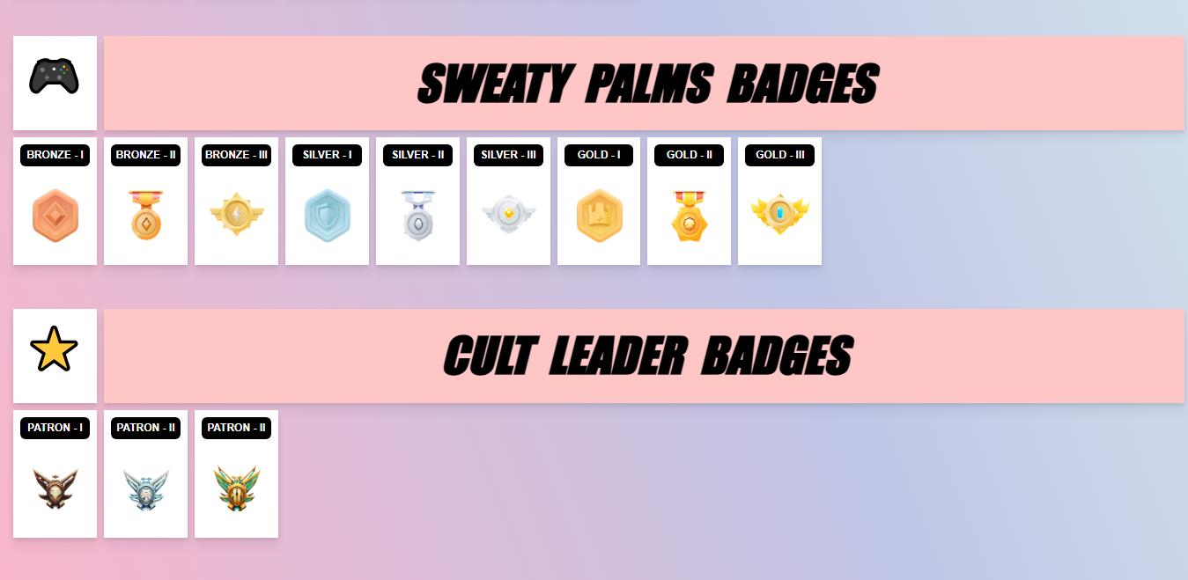
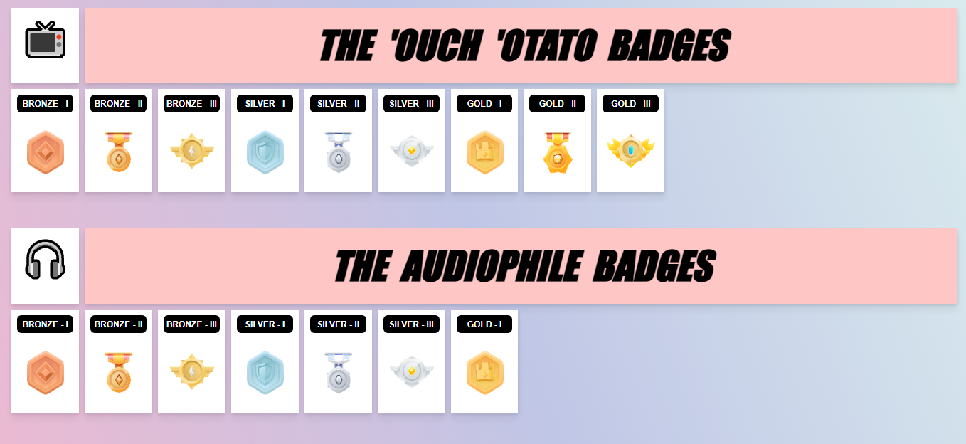
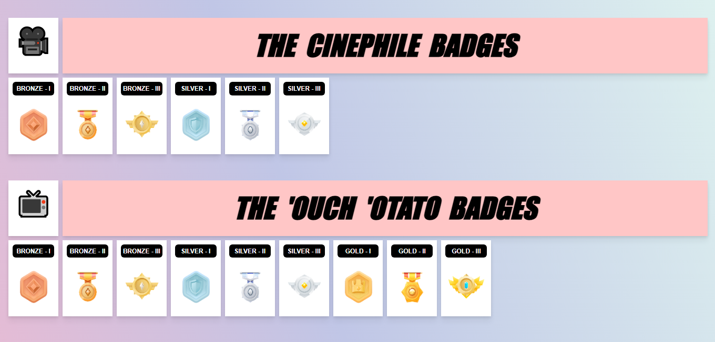
badges.php

Slide 35
DETAILS HERE
This page displays the badges earned by the user for each media type. There are also badges for patrons and users with most followers. Content on this is rendered based on PHP conditionals.
An array is used to store all the configurations where [0] stores the image path, [1] stores the badge name and [2] stores the required number of media items to earn the badge.
By default, this page shows the badges of the logged in user and if a GET request is made with the user_name attribute it displays the badges of other users if the GET request parameter passed is valid.
For CSS, A Responsive Grid is used with ‘em’ and ‘rem’ sizes to display the container of the badges. In case a user has not achieved any badges, only the title section is printed with the container being empty.
For each badge, the PHP logic code accesses the respective array index to determine whether the badge is to be shown or not.

Slide 36
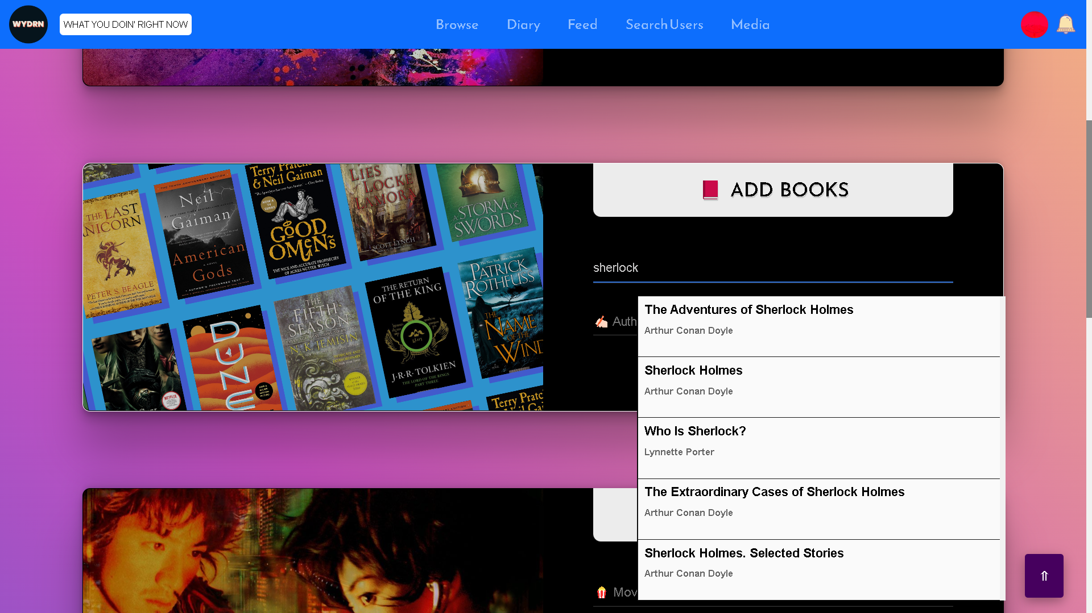
SearchBoxAPIs/Book/index.html

Slide 37
API DETAILS FOR BOOK SEARCH
API USED: GoogleBooks API (https://developers.google.com/books/docs/v1/using) Application name: WYDRN API key: N/A (None Required to Access Publicly Avaiable Data)
This is an API Driven feature where the user enters a search query and the search results are populated with the associated data fetched from the Google Books API.
Javascript is used to dynamically generate the HTML and CSS content as the size of the fetched JSON grows or shrinks.
When a user makes a choice and selects it, an index of media element is stored in a variable that is used to set the value of the input field to it.
The secondary input field is set as disabled as the value of it is autofilled based on the choice made by the user.

Slide 38
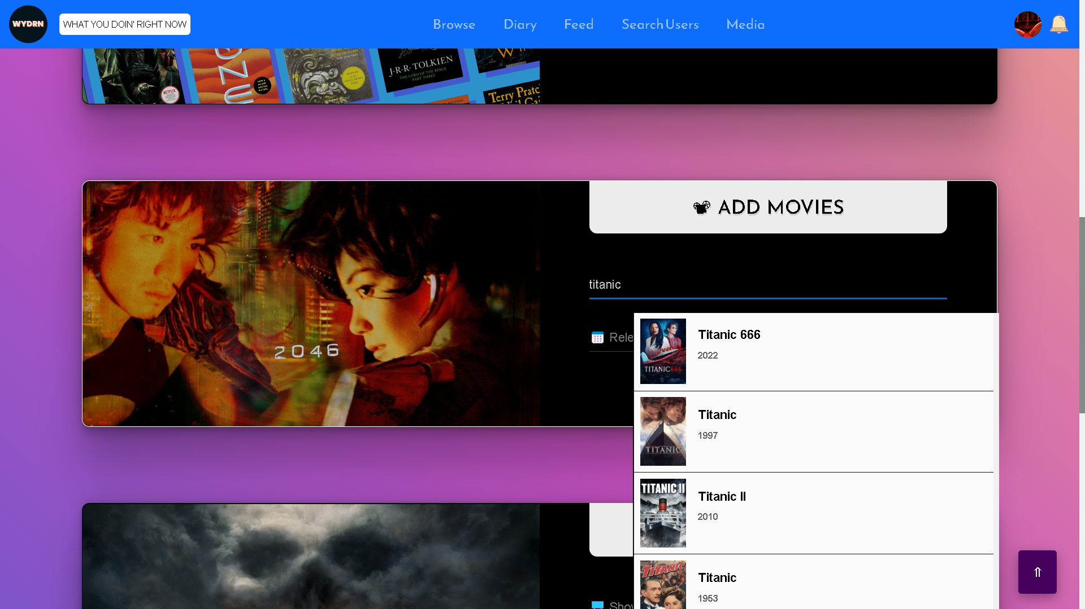
SearchBoxAPIs/Movie/index.html

Slide 39
API DETAILS FOR MOVIE SEARCH
API USED: TMDB [Television and Movie Database] API (https://developers.themoviedb.org/3/getting-started/introduction) Application name: Movie-Web-App API key: e446bc89015229cf337e16b0849d506c Registered to: HighnessAtharva
This is an API Driven feature where the user enters a search query and the search results are populated with the associated data fetched from the TMDB API.
Javascript is used to dynamically generate the HTML and CSS content as the size of the fetched JSON grows or shrinks.
When a user makes a choice and selects it, an index of media element is stored in a variable that is used to set the value of the input field to it.
The secondary input field is set as disabled as the value of it is autofilled based on the choice made by the user.

Slide 40
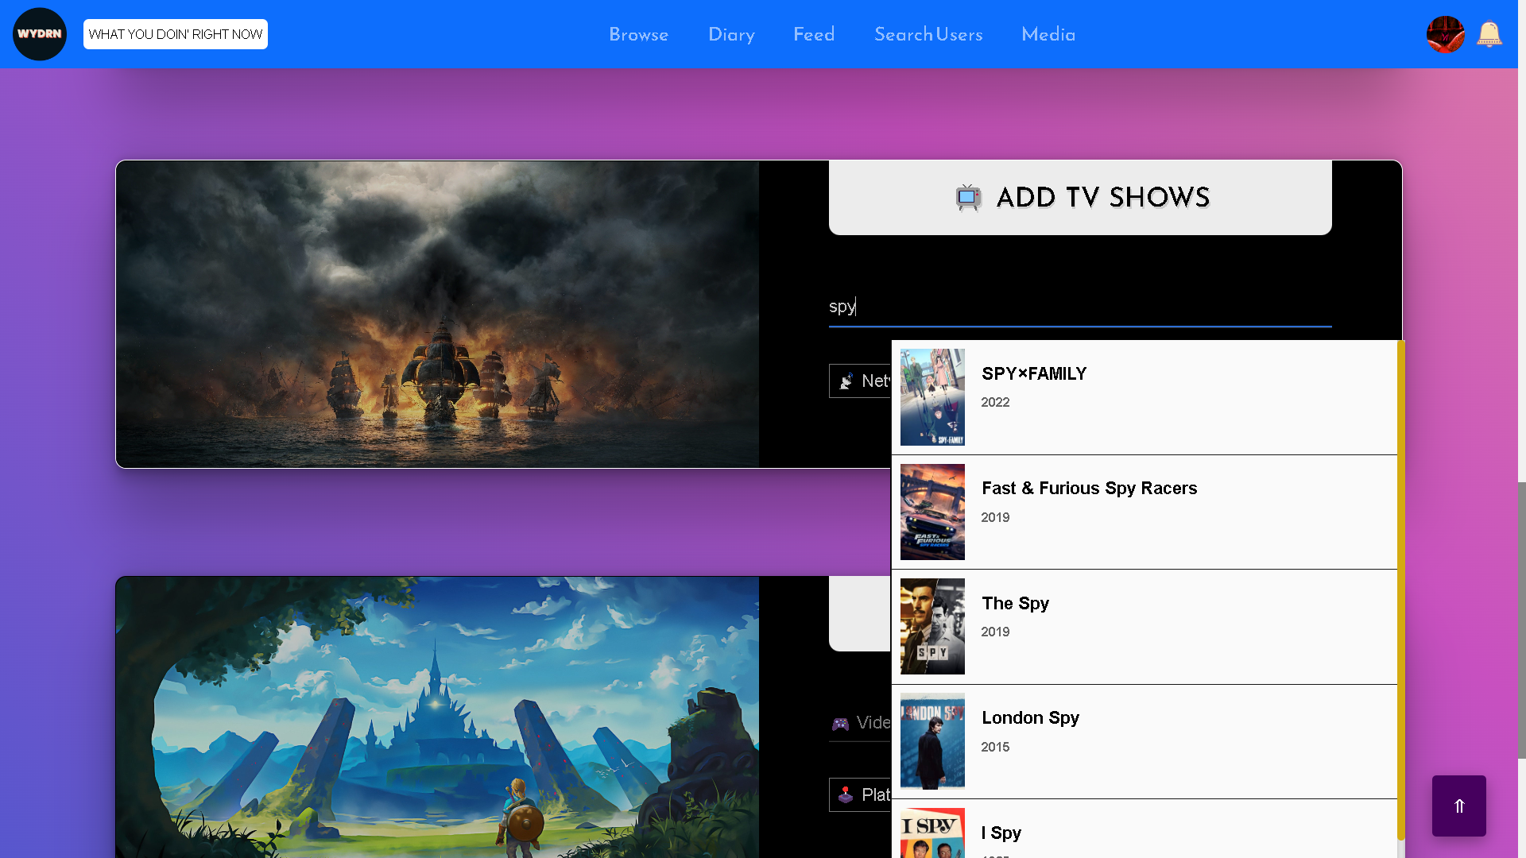
SearchBoxAPIs/TV/index.html

Slide 41
API USED: TMDB [Television and Movie Database] API
(https://developers.themoviedb.org/3/getting-started/introduction)
Application name: Movie-Web-App
API key: e446bc89015229cf337e16b0849d506c
Registered to: HighnessAtharva
This is an API Driven feature where the user enters a search query and the search results are populated with the associated data fetched from the TMDB API.
Javascript is used to dynamically generate the HTML and CSS content as the size of the fetched JSON grows or shrinks.
When a user makes a choice and selects it, an index of media element is stored in a variable that is used to set the value of the input field to it.
The secondary input field is set as disabled as the value of it is autofilled based on the choice made by the user.
API DETAILS FOR TV SERIES SEARCH

Slide 42
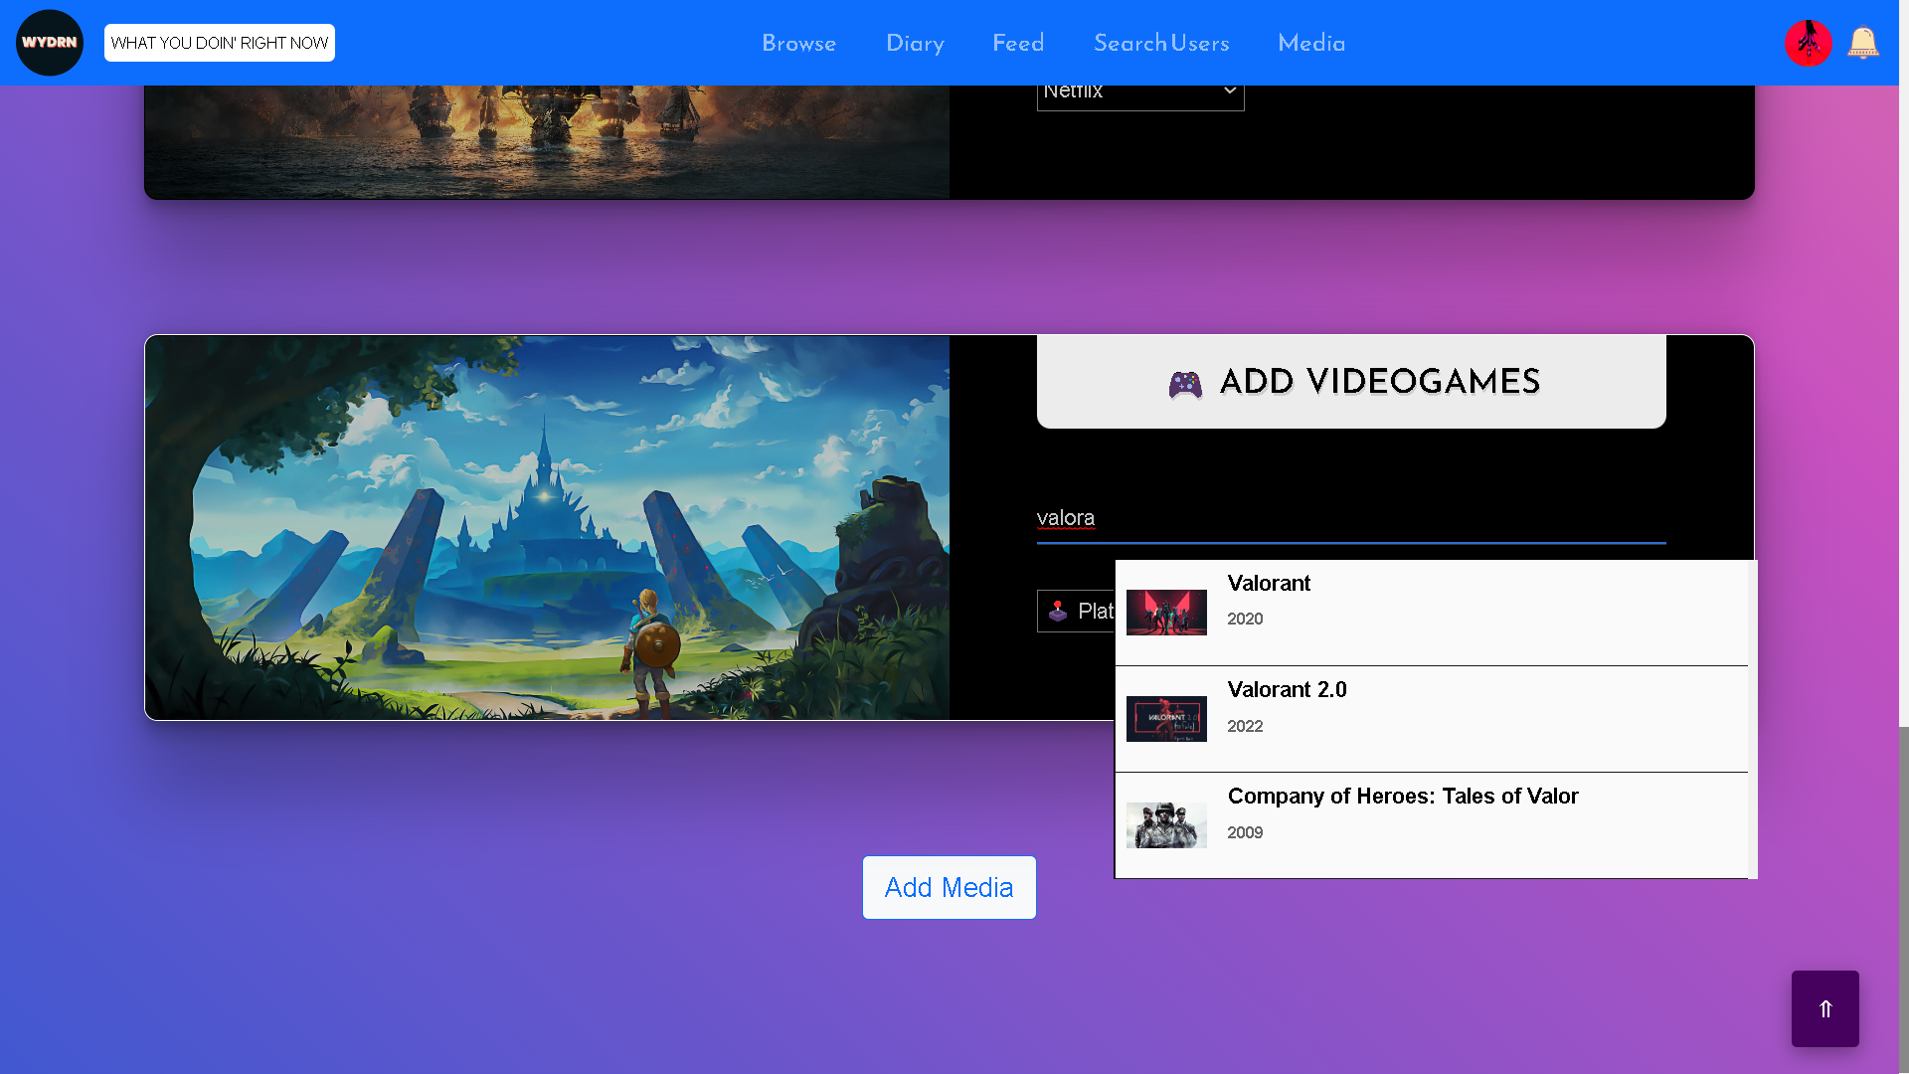
SearchBoxAPIs/Videogames/index.html

Slide 43
API USED: RAWG API (https://rawg.io/apidocs) Application name: WYDRN API key: fe197746ce494b4791441d9a9161c1be Registered to: HighnessAtharva Rate Limit: 20000 requests per month. Renews on 12th of every month
This is an API Driven feature where the user enters a search query and the search results are populated with the associated data fetched from the Steam API.
Javascript is used to dynamically generate the HTML and CSS content as the size of the fetched JSON grows or shrinks.
When a user makes a choice and selects it, an index of media element is stored in a variable that is used to set the value of the input field to it.
The secondary input field is set as disabled as the value of it is autofilled based on the choice made by the user.
API DETAILS FOR VIDEOGAME SEARCH

Slide 44
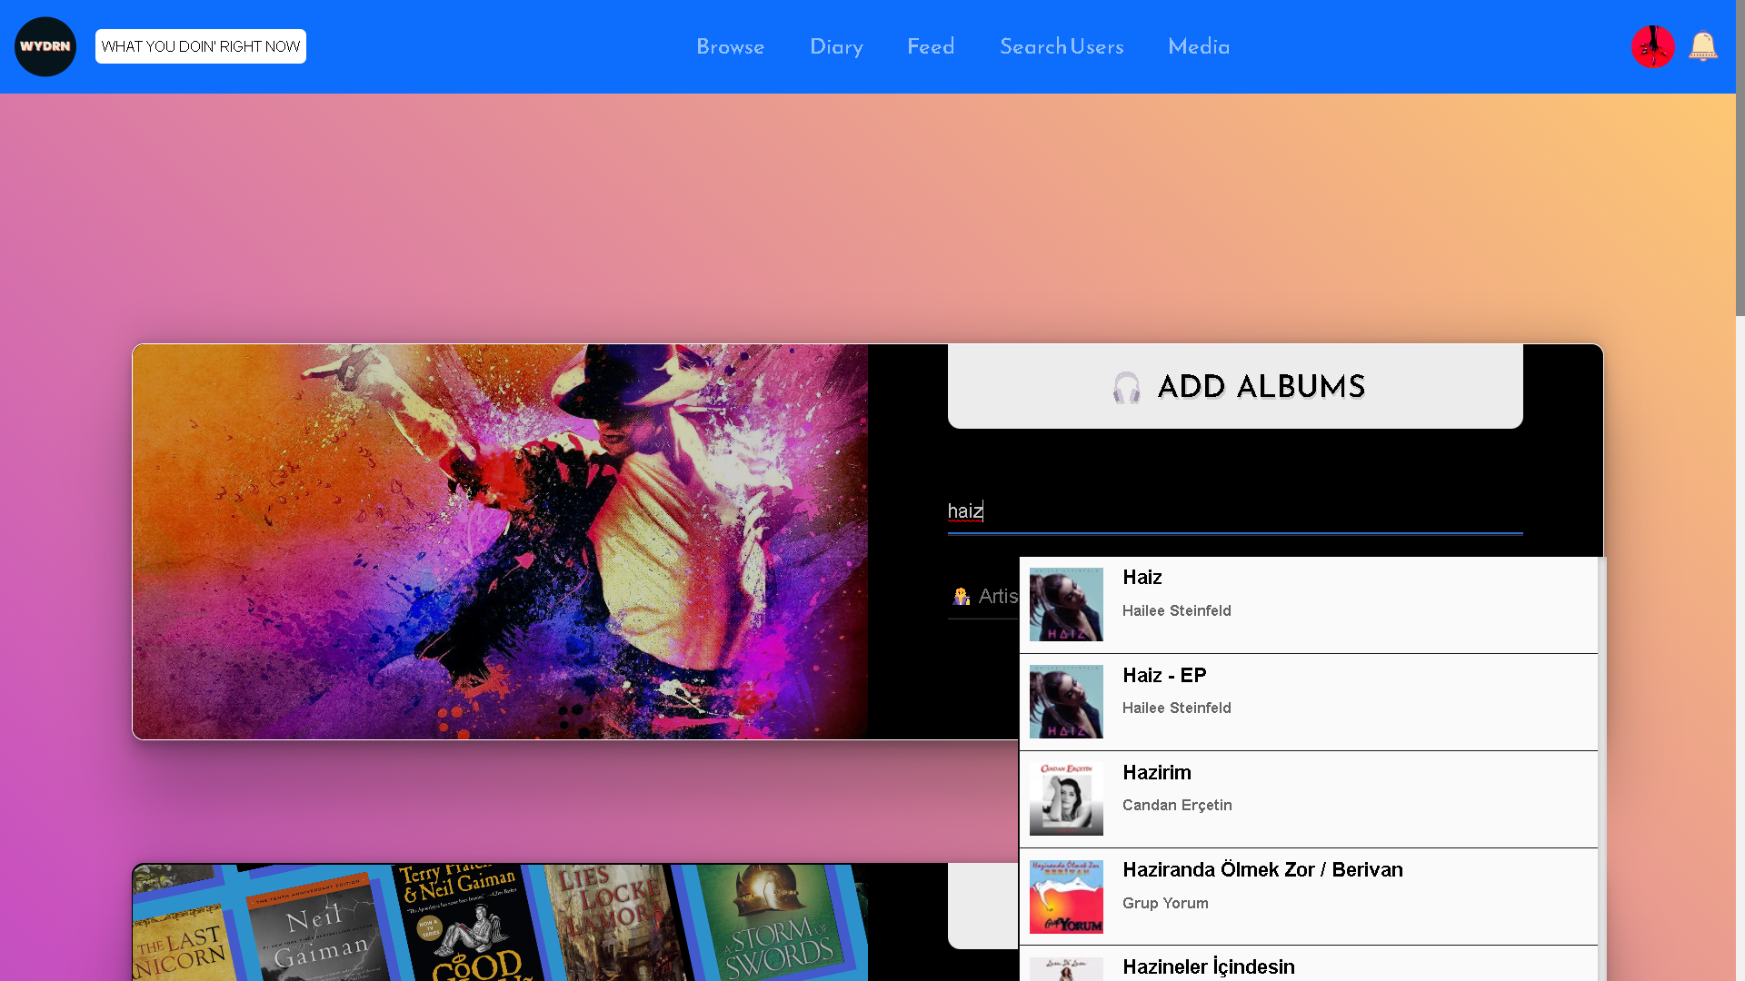
SearchBoxAPIs/Album/index.html

Slide 45
API DETAILS HERE
API USED: LastFM (https://www.last.fm/api) Application name: WYDRN API key: 6a4eb1d0536cfe3583784a65332ee179 Shared-secret: c953036f143092a6f452413b1a13d8ea Registered to: HighnessAtharva
This is an API Driven feature where the user enters a search query and the search results are populated with the associated data fetched from the Last.FM API
Javascript is used to dynamically generate the HTML and CSS content as the size of the fetched JSON grows or shrinks.
When a user makes a choice and selects it, an index of media element is stored in a variable that is used to set the value of the input field to it.
The secondary input field is set as disabled as the value of it is autofilled based on the choice made by the user.

Slide 46
header.php
This file is responsible for showing the navbar at the top of every page once the user is logged in. It shows the user profile pic, the site logo, and the navigation items along with the respective dropdowns.
Browse and Media sections show a dropdown on clicking and display options that takes users to the respective pages.
Clicking on the profile icon shows drop down allowing users to view user options along with import/export option.
Bell icon next to profile picture takes users to their notification.
Header is sticky to the top and shrinks on scrolling. Responsive in nature.
The page first selects the profile pic of the user from the ‘users’ table where user id is $id.
Page runs an SQL query where it selects the profile pic of the user with user $id and then verifies if the row in the database is not empty.
“@media” media rule is used to to apply criteria for the desktop view.

Slide 47
logout.php
This file performs only backend functions and does not include any markup.
Logs out the user. Redirects to the login page and destroys the session.

Slide 48
functions.php
There are total 51 functions in functions.php files which are required throughout the project.
function check_login($con)
function random_num($length)
function mailer_verify_email($recipient)
function send_reset_link($recipient, $link)
function check_verified_status($username)
function set_verified($username)
function check_active_status($username)
function set_active($username)
function set_inactive($username)
function printable_datetime($datetime)
function get_mutual_media_count($user1, $user2)
function executeSQL($con, $sql)
function randomImage()
function randomVideo()
function getRandomGradient()
function getRandomBookQuote()
function getRandomMovieQuote()
function getRandomTvQuote()
function getRandomVideoGameQuote()

Slide 49
Functions
function getDateofJoining($con, $username)
function getTotalMediaCount($con, $username)
function getTotalMediaCountUnique($con, $username)
function getTotalMediaAddedLastWeek($con, $username)
function getTotalMediaAddedLastMonth($con, $username)
function getTotalMediaAddedLast3Months($con, $username)
function getTotalMediaAddedLast6Months($con, $username)
function getTotalMediaAddedLastYear($con, $username)
function getTotalBooksCount($con, $username)
function getTotalBooksCountUnique($con, $username)
function getFavoriteBook($con, $username)
function getFavoriteAuthor($con, $username)
function getTotalMoviesCount($con, $username)
function getTotalMoviesCountUnique($con, $username)
function getFavoriteMovie($con, $username)
function getTotalTVCountUnique($con, $username)
function getFavoriteTV($con, $username)
function getFavoriteStreamingPlatform($con, $username)
function getTotalVideoGameCount($con, $username)

Slide 50
Functions
function getTotalVideoGameCountUnique($con, $username)
function getFavoriteGamingPlatform($con, $username)
function getFavoriteVideoGame($con, $username)
function getTotalAlbumCount($con, $username)
function getTotalAlbumCountUnique($con, $username)
function getFavoriteAlbum($con, $username)
function getFavoriteArtist($con, $username)
function MoviePosterPath($name, $year)
function BookPosterPath($name, $author)
function TvPosterPath($name)
function MusicPosterPath($name, $artist)
function GamePosterPath($name)
function getRandomAlbumQuote()

Slide 51
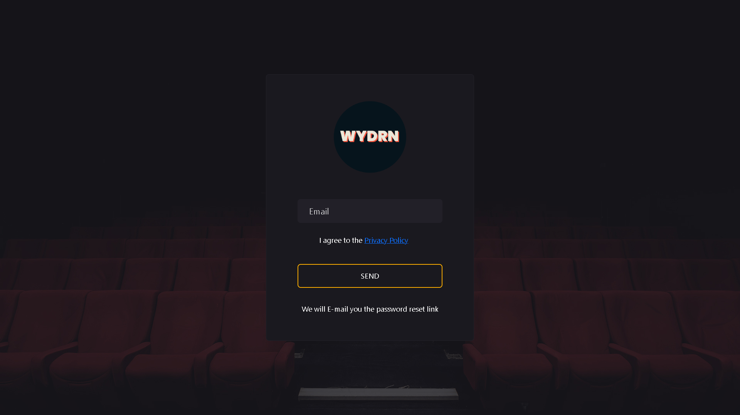
reset_pass.php

Slide 52
DETAILS HERE

Slide 53
connection.php
Establishes connections with the WYDRN database.
$dbhost = "localhost";
$dbuser = "root";
$dbpass = "";
$dbname = "WYDRN";
The page runs mysqli_connect() function to establish a connection with MySQL server.

Slide 54
delete_item.php
This is a back-end utility file.
Depending on the GET request passed (i.e. media type) the item is deleted from the database. This page is linked with your media pages.
For example, if a book needs to be deleted a GET request is made from media_books page with the book parameter and the name of the book is passed as the value.
This file updates the data table and sets the book and author name to nullified string where the book value matches the GET request book name and hence results in the effect of a “deletion” operation.
Similarly, the logic for the other 4 media item follows

Slide 55
delete_user_confirm.php
This file performs only backend functions and does not include any markup.
Checks if a user has Logged IN and if so, Deletes the user data from the database.

Slide 56
search_users_ajax.php
This file performs only backend functions and does not include any markup.
Displays data from the database Asynchronously on the search_users page. delete_user_confirm.php -

Slide 57
clear.php
This file performs only backend functions and does not include any markup.
Clears the users' profile page by inserting a blank row in the Database.

Slide 58

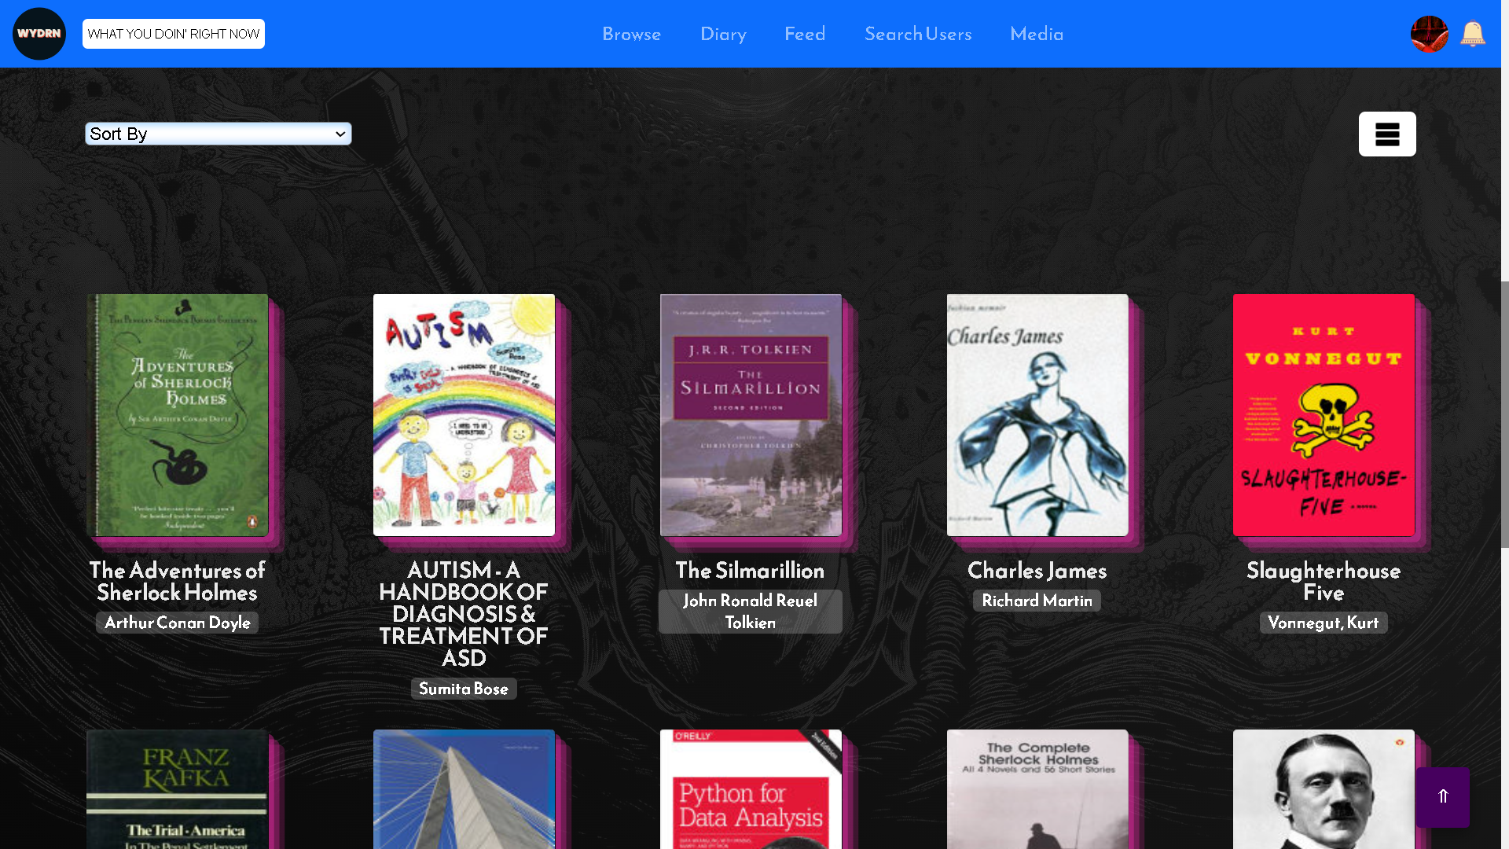
media_book.php

Slide 59
DETAILS HERE
This page shows non-duplicate movies logged by the user in a grid/gallery form. On hovering on an item the date of logging is displayed.
The page makes use of the TMDB(Television and Movie Database) API.
The data is fetched from the 'data' table.
The user can sort the data on the basis of various parameters such as Added date(Newest to oldest or oldest to newest) Release date(Newest to oldest or oldest to Newest) and also alphabetically(A-Z or Z-A).

Slide 60
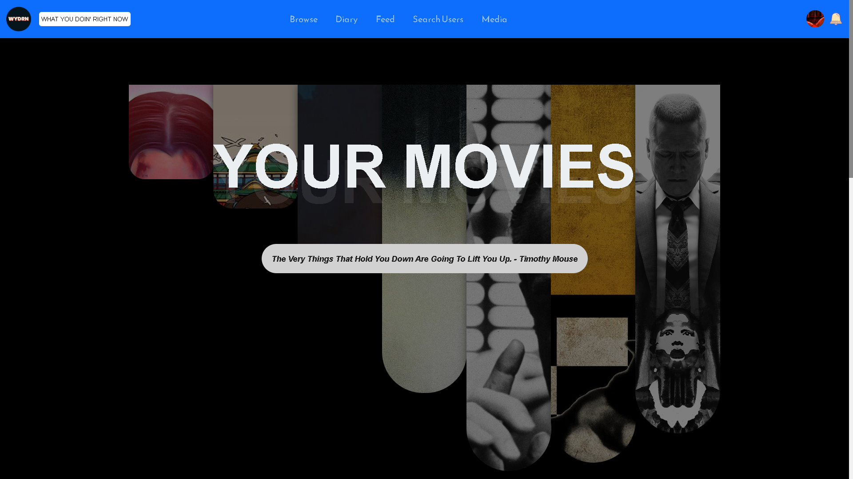
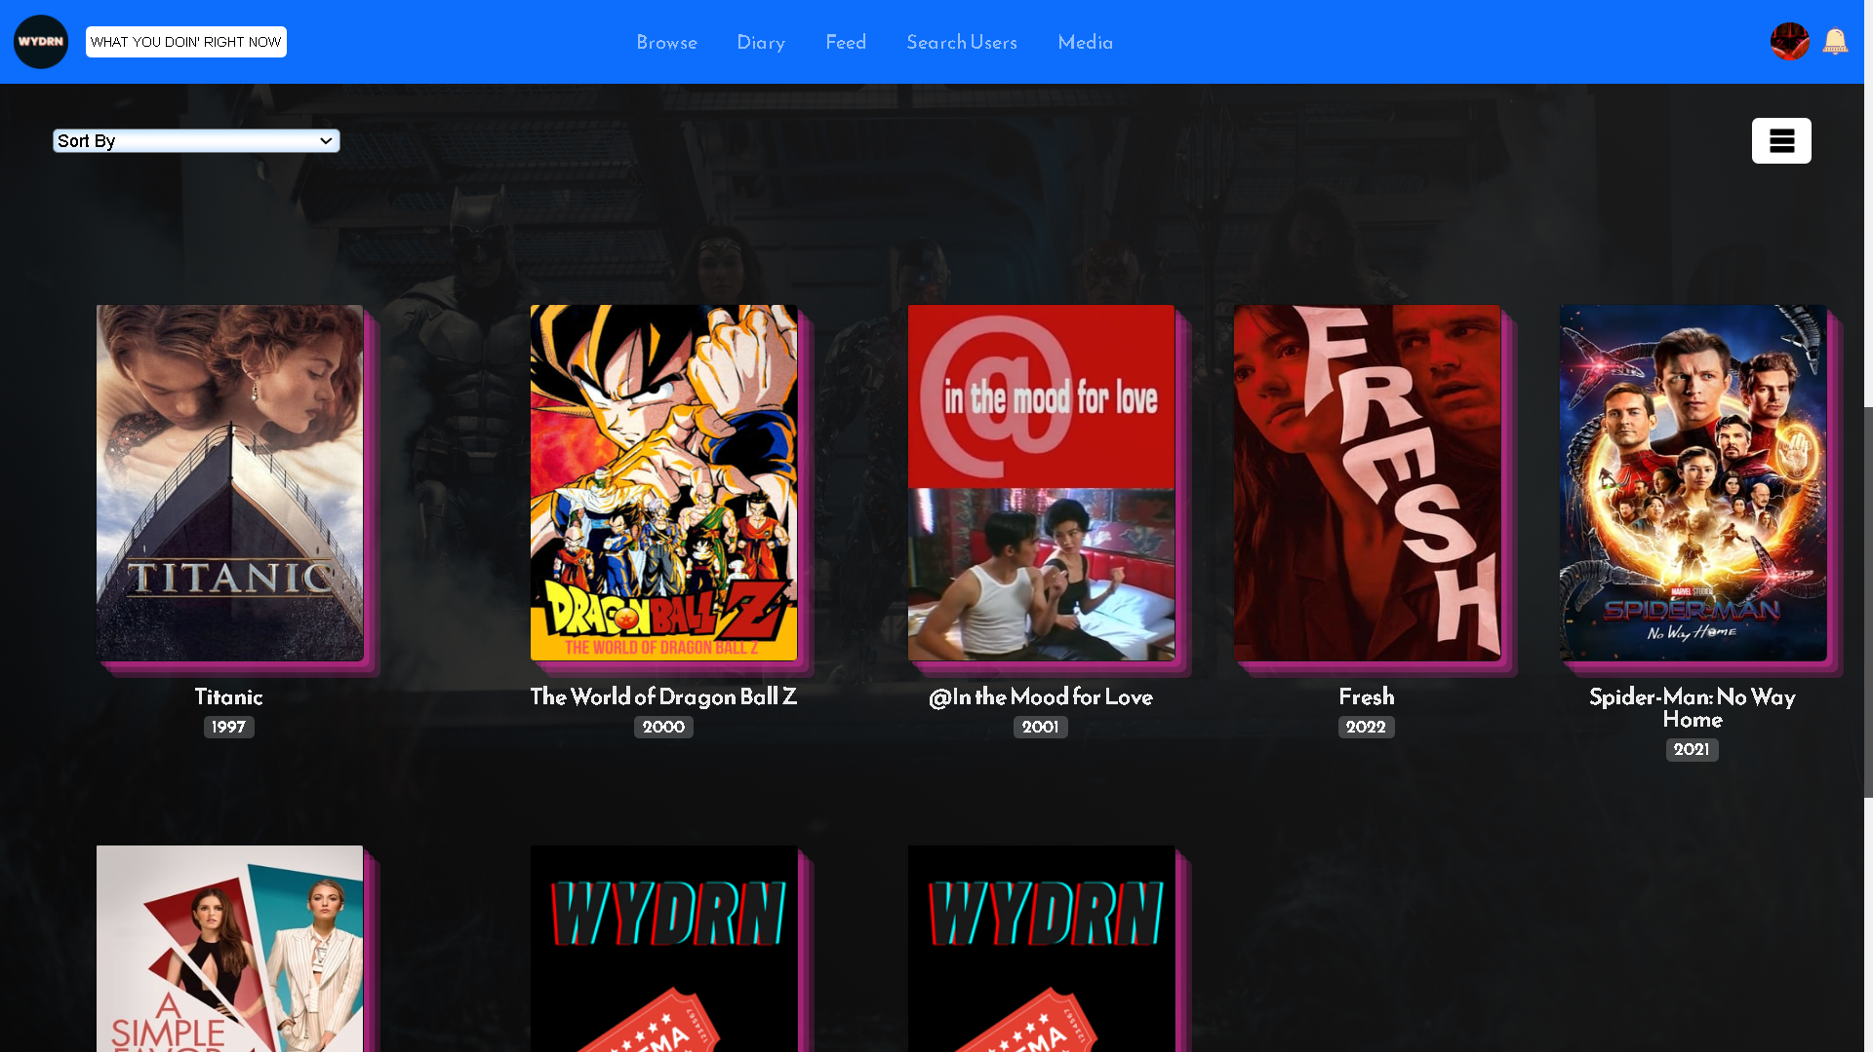
media_movie.php

Slide 61
DETAILS HERE
This page shows non-duplicate music logged by the user in a grid/gallery form. On hovering on an item, the date of logging is displayed.
The page makes use of the Last.FM API.
The data is fetched from the 'data' table.
The user can sort the data on the basis of various parameters such as Added date(Newest to oldest or oldest to newest) Release date(Newest to oldest or oldest to Newest) and also alphabetically(A-Z or Z-A).

Slide 62
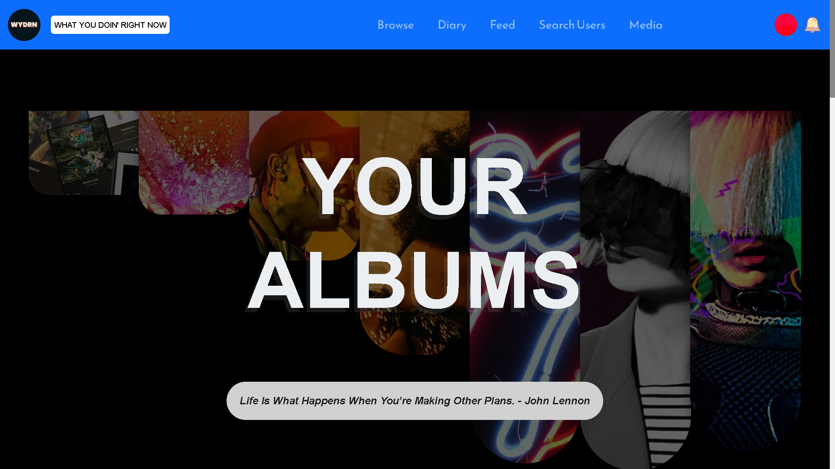
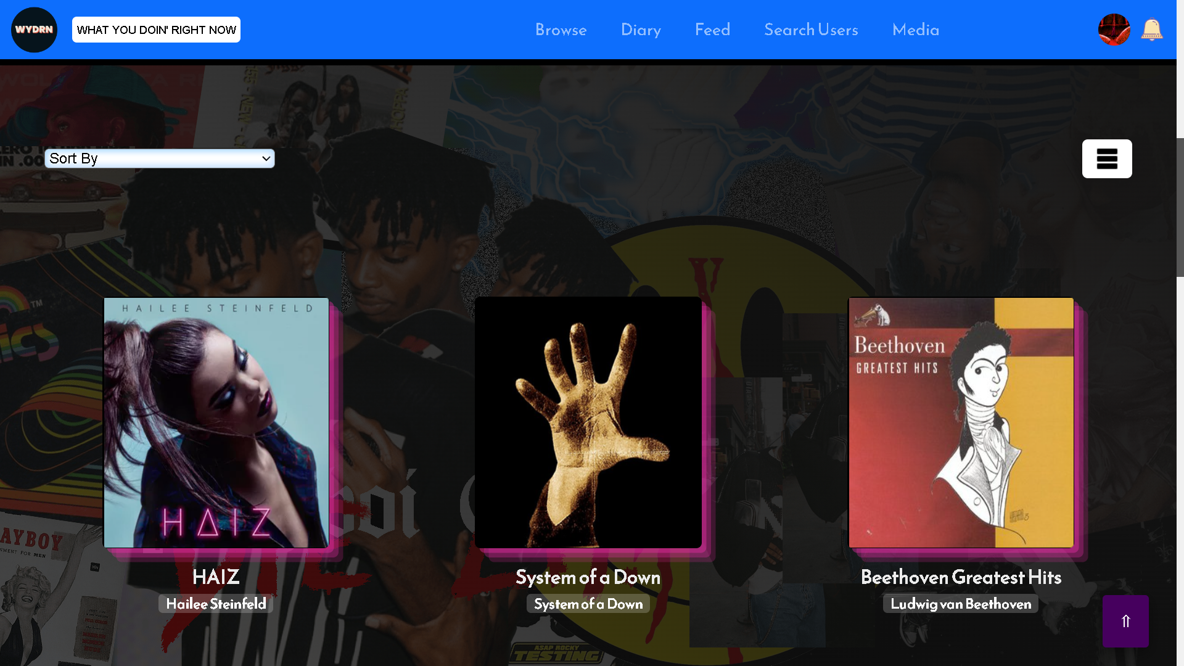
media_music.php

Slide 63
DETAILS HERE
This page shows non-duplicate music logged by the user in a grid/gallery form. On hovering on an item, the date of logging is displayed.
The page makes use of the Last.FM API.
The data is fetched from the 'data' table.
The user can sort the data on the basis of various parameters such as Added date(Newest to oldest or oldest to newest) Release date(Newest to oldest or oldest to Newest) and also alphabetically(A-Z or Z-A).

Slide 64
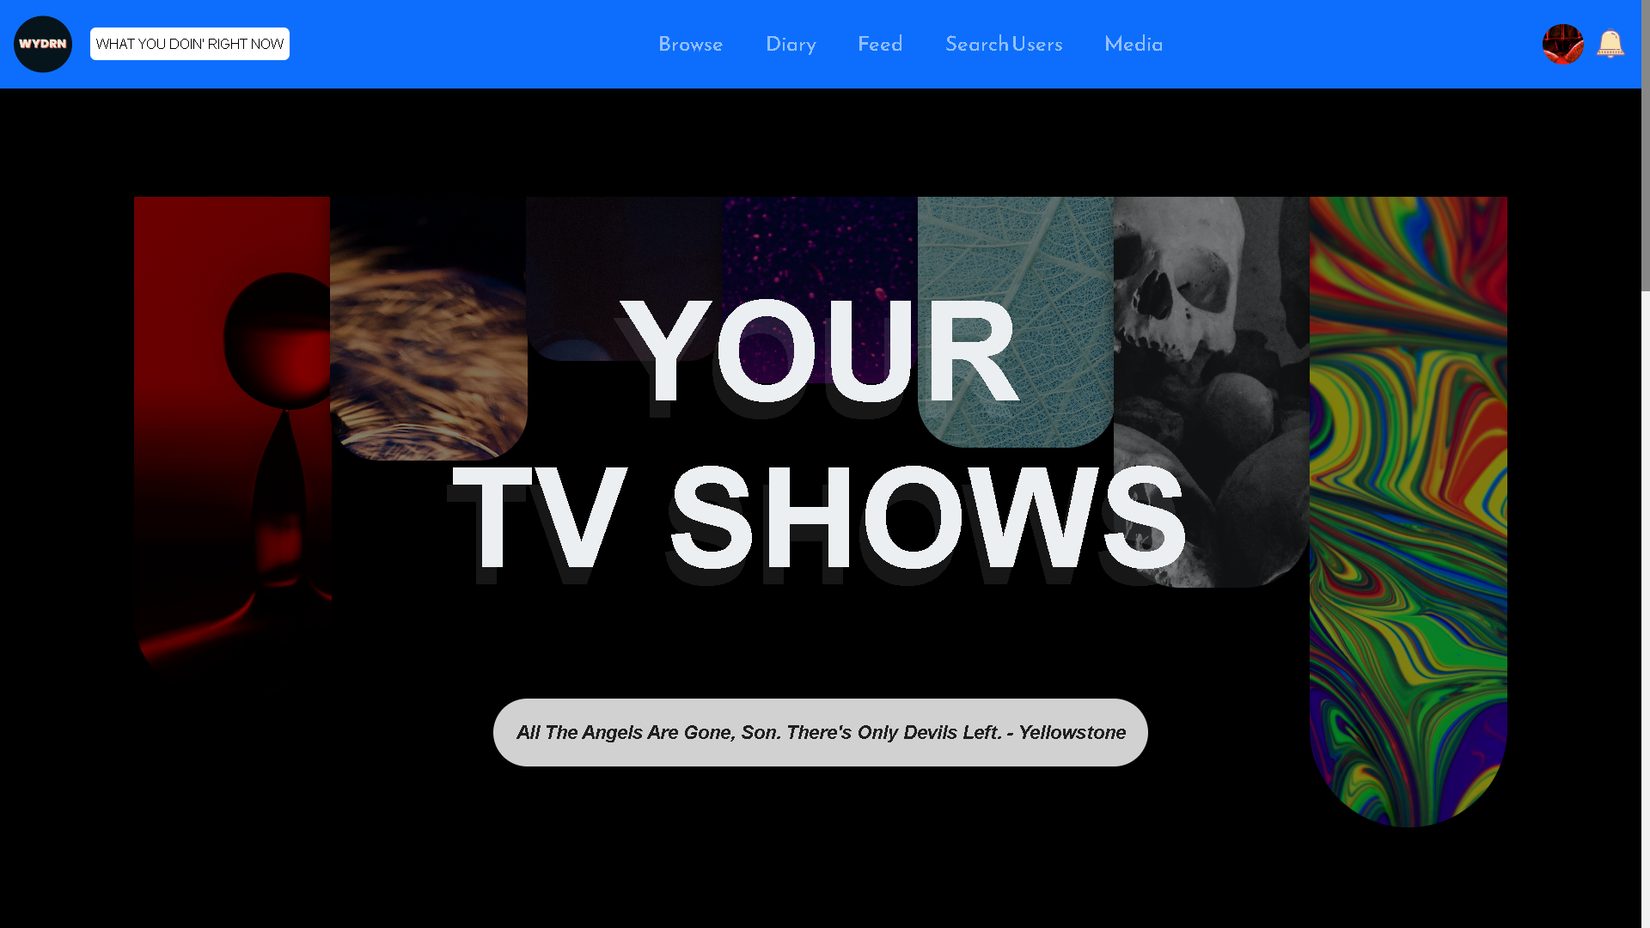
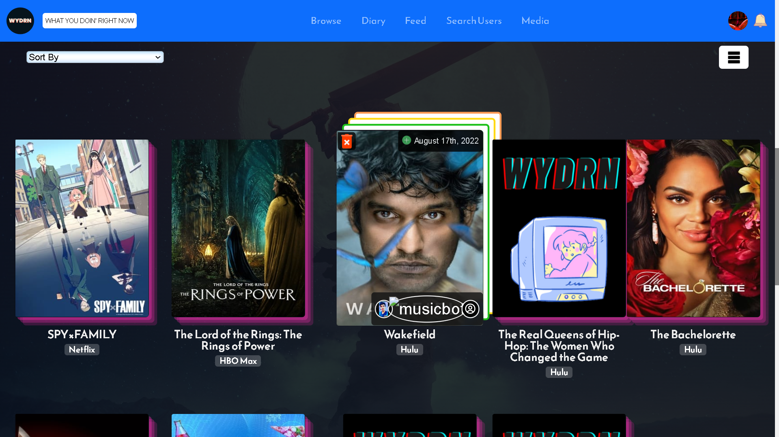
media_tv.php

Slide 65
DETAILS HERE
This page shows non-duplicate tv shows logged by the user in a grid/gallery form. On hovering on an item, the date of logging is displayed.
The page makes use of the TMDB(Television and Movie Database) API.
The data is fetched from the 'data' table.
The user can sort the data on the basis of various parameters such as Added date (Newest to oldest or oldest to newest) Release date(Newest to oldest or oldest to Newest) and also alphabetically(A-Z or Z-A).

Slide 66
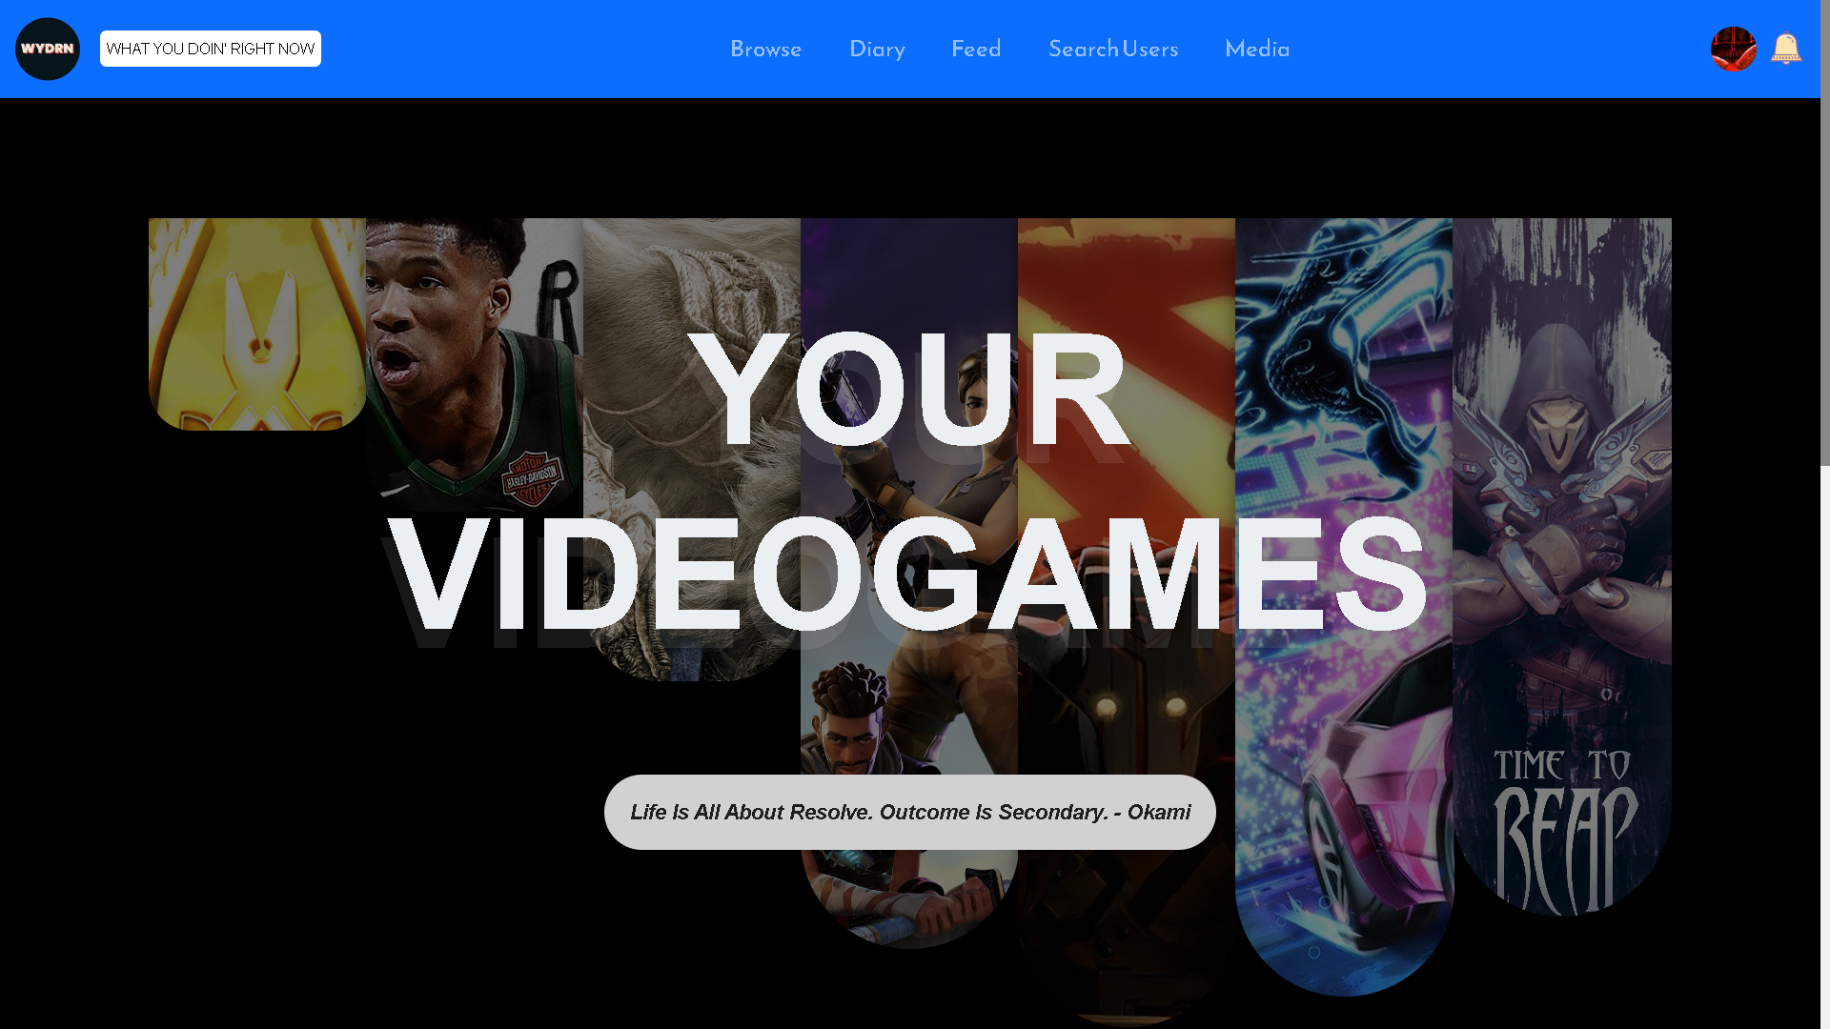
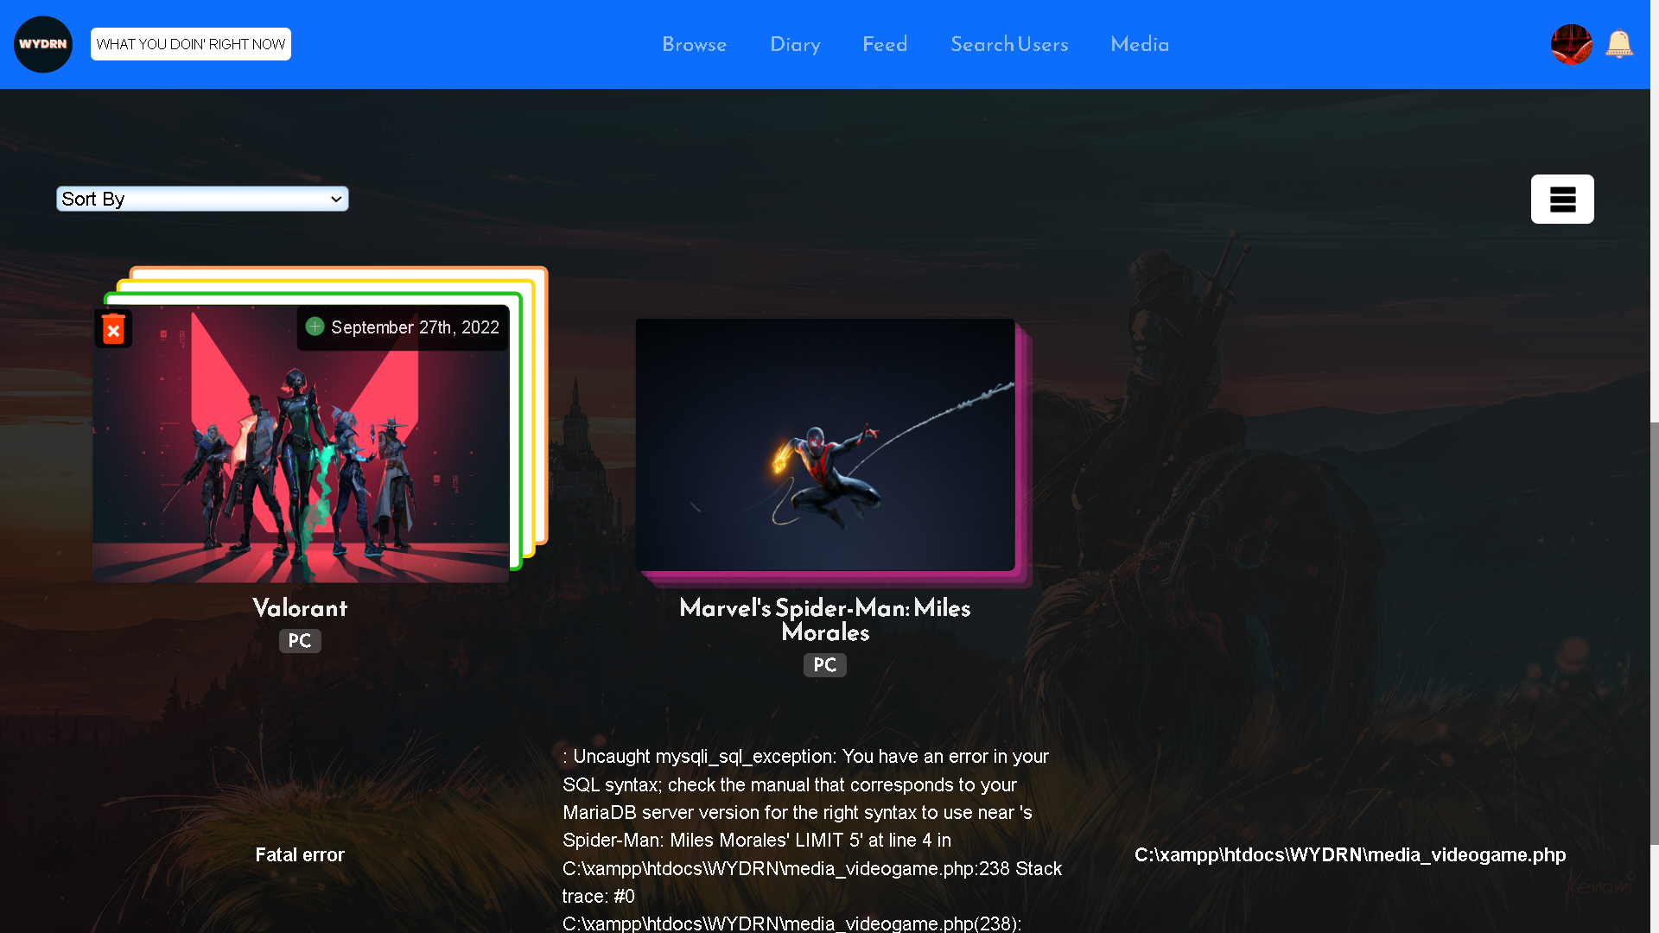
media_videogame.php

Slide 67
DETAILS HERE
This page shows non-duplicate videogames logged by the user in a grid/gallery form. On hovering on an item, the date of logging is displayed.
A GET Request method is used on this page.
The page makes use of the RAWG API.
The data is fetched from the 'data' table.

Slide 68
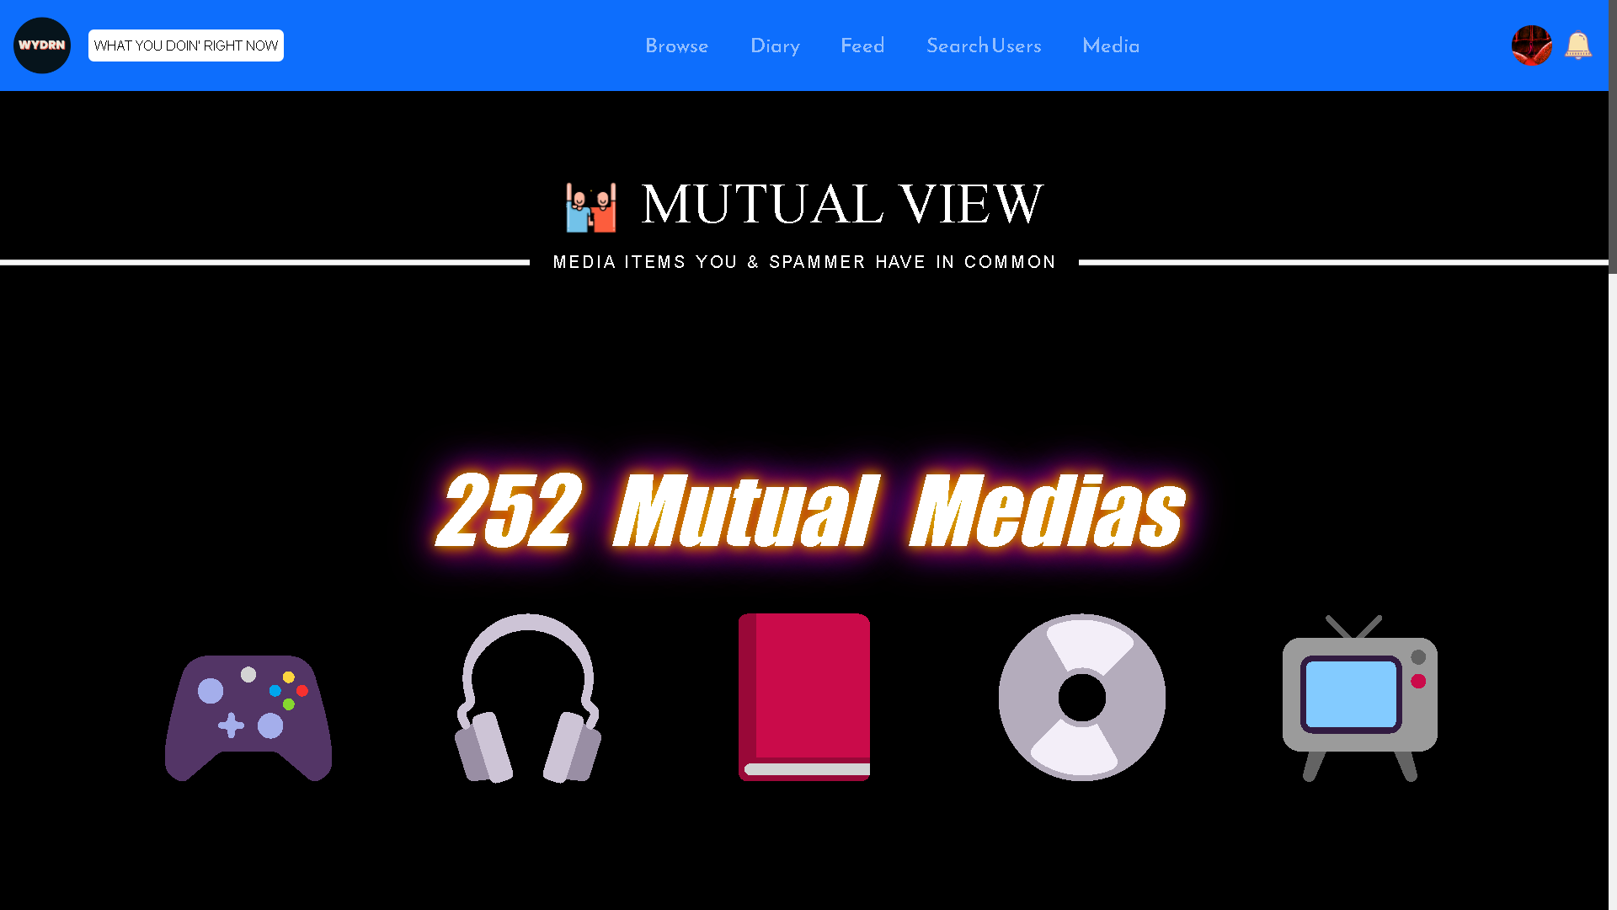
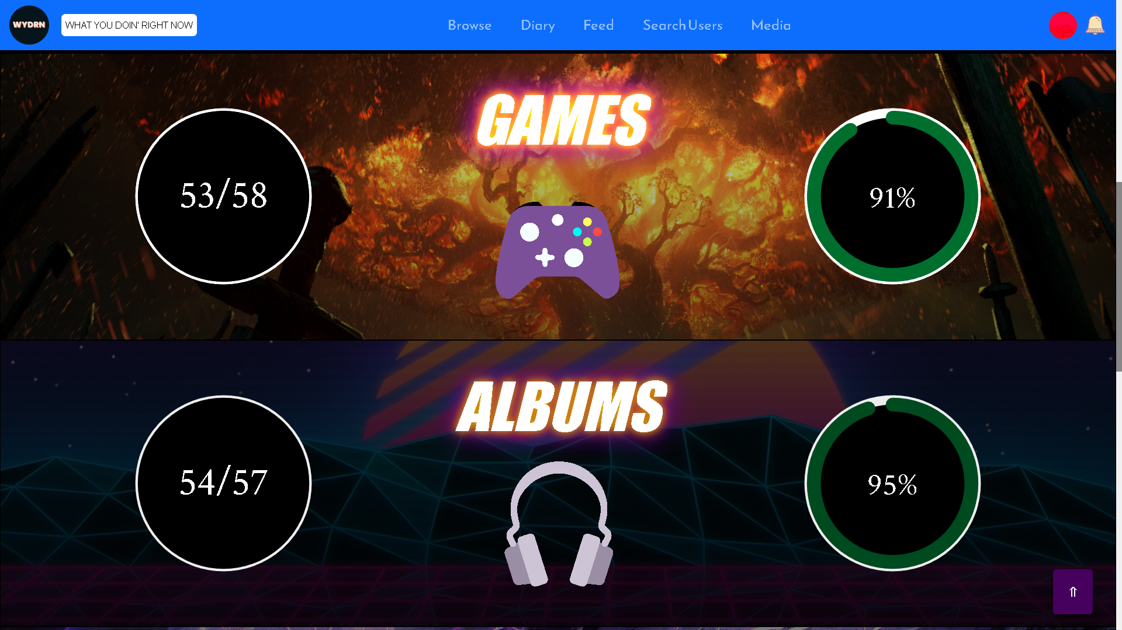
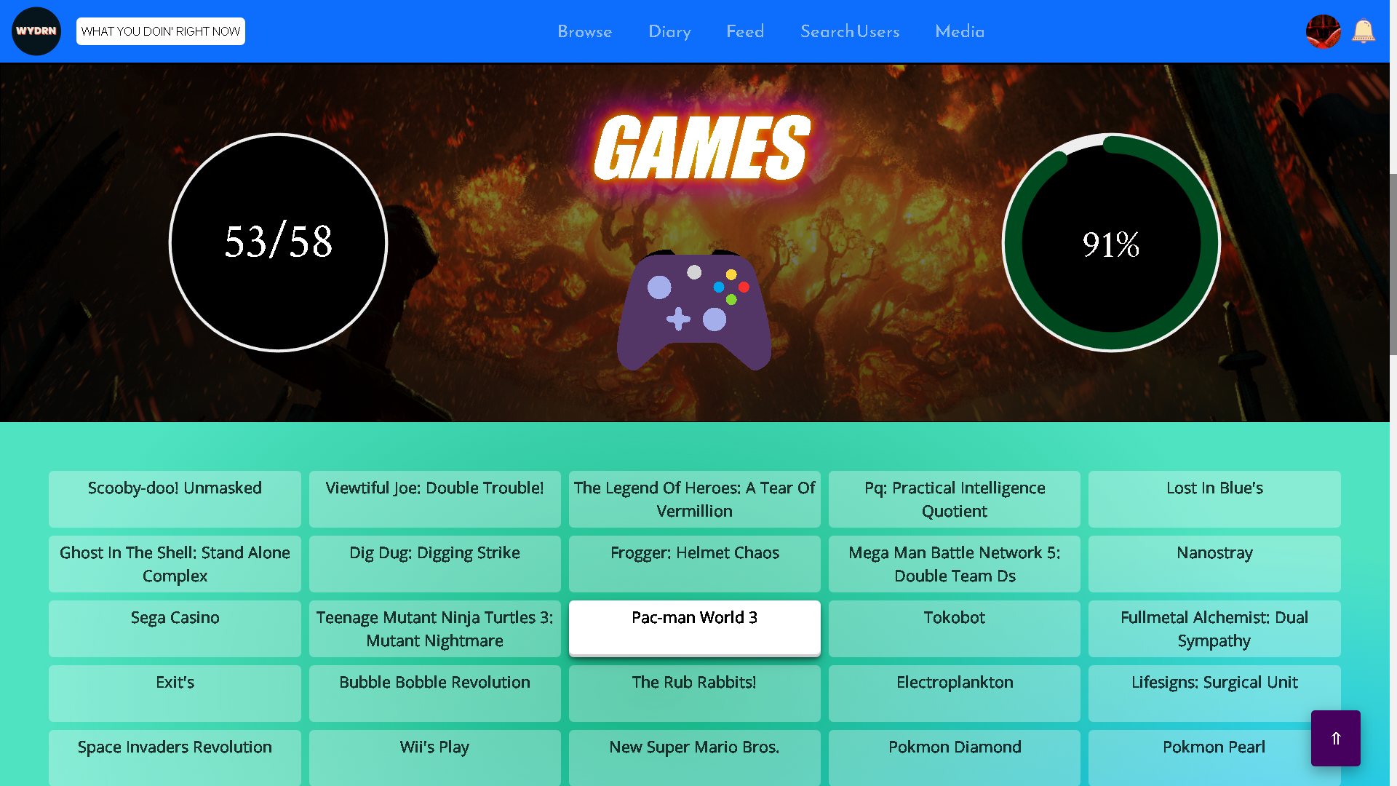
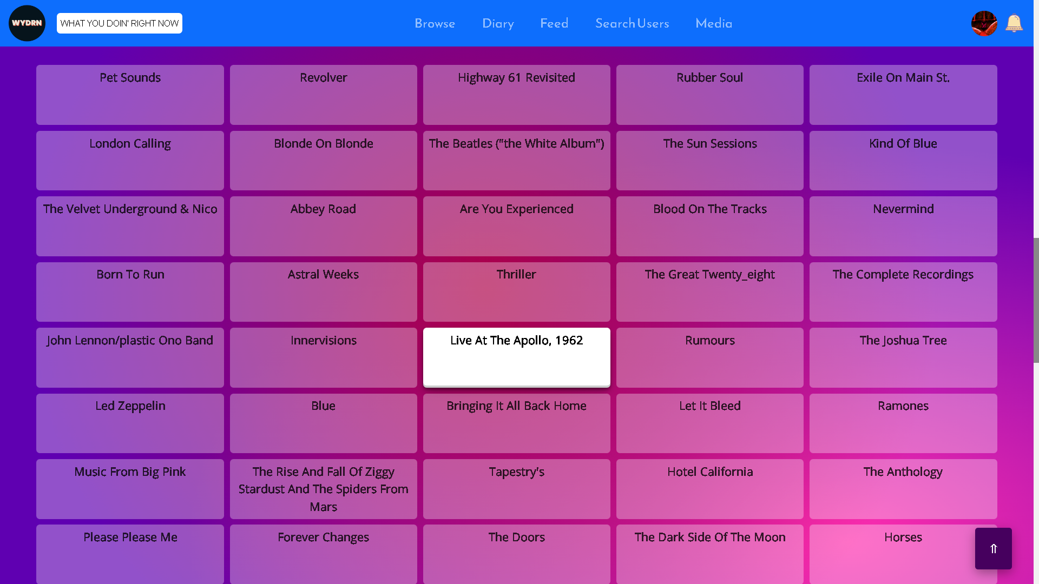
mutual_view.php

Slide 69
DETAILS HERE
Music, books, movies, video games & TV Shows that are in common with other users can be seen on this page by the user.
User can arrive on this page by clicking the "mutual media" button on the profile of other users.
This page uses _GET method.
The data is fetched from the 'data' table

Slide 70
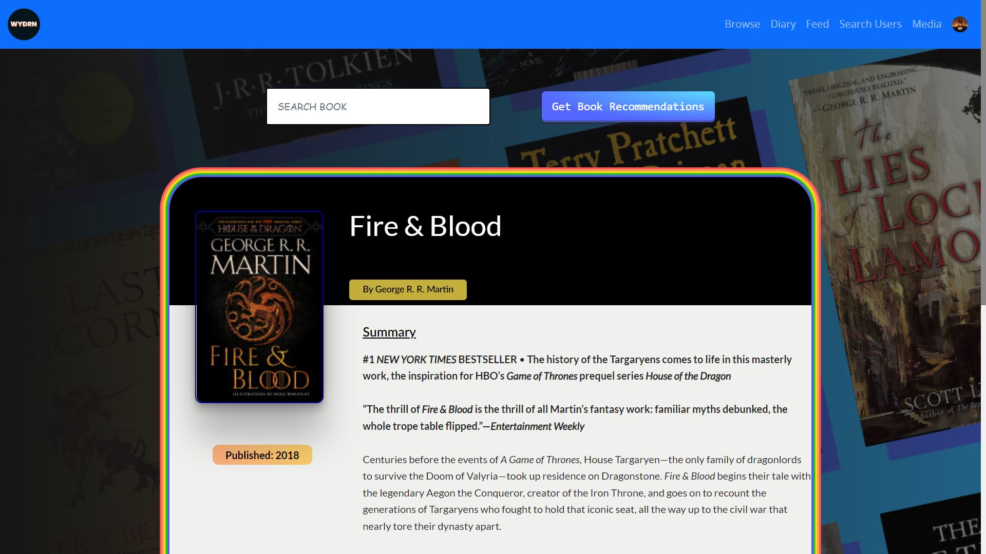
MediaAPIs/Book/index.php

Slide 71
DETAILS HERE
This page is used to find information for any book searched by the user.
The page makes use of the Google Books API.

Slide 72
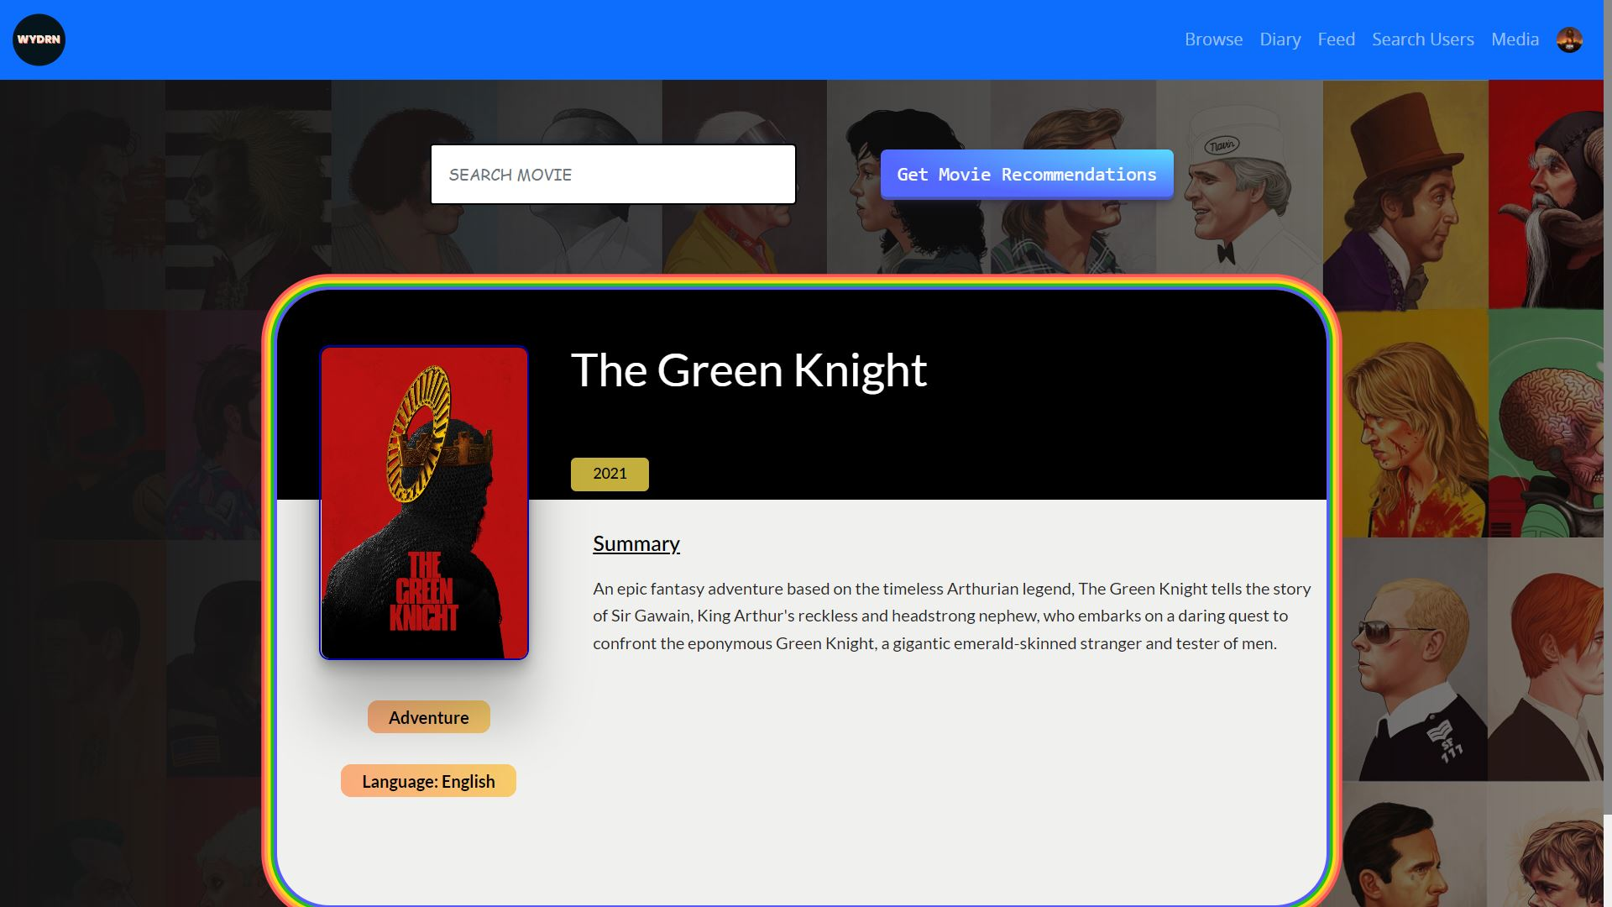
MediaAPIs/Movies/index.php
HERE

Slide 73
DETAILS HERE
This page is used to find information for any Movie searched by the user.
The page makes use of the TMDB(Television and Movie Database) API.

Slide 74
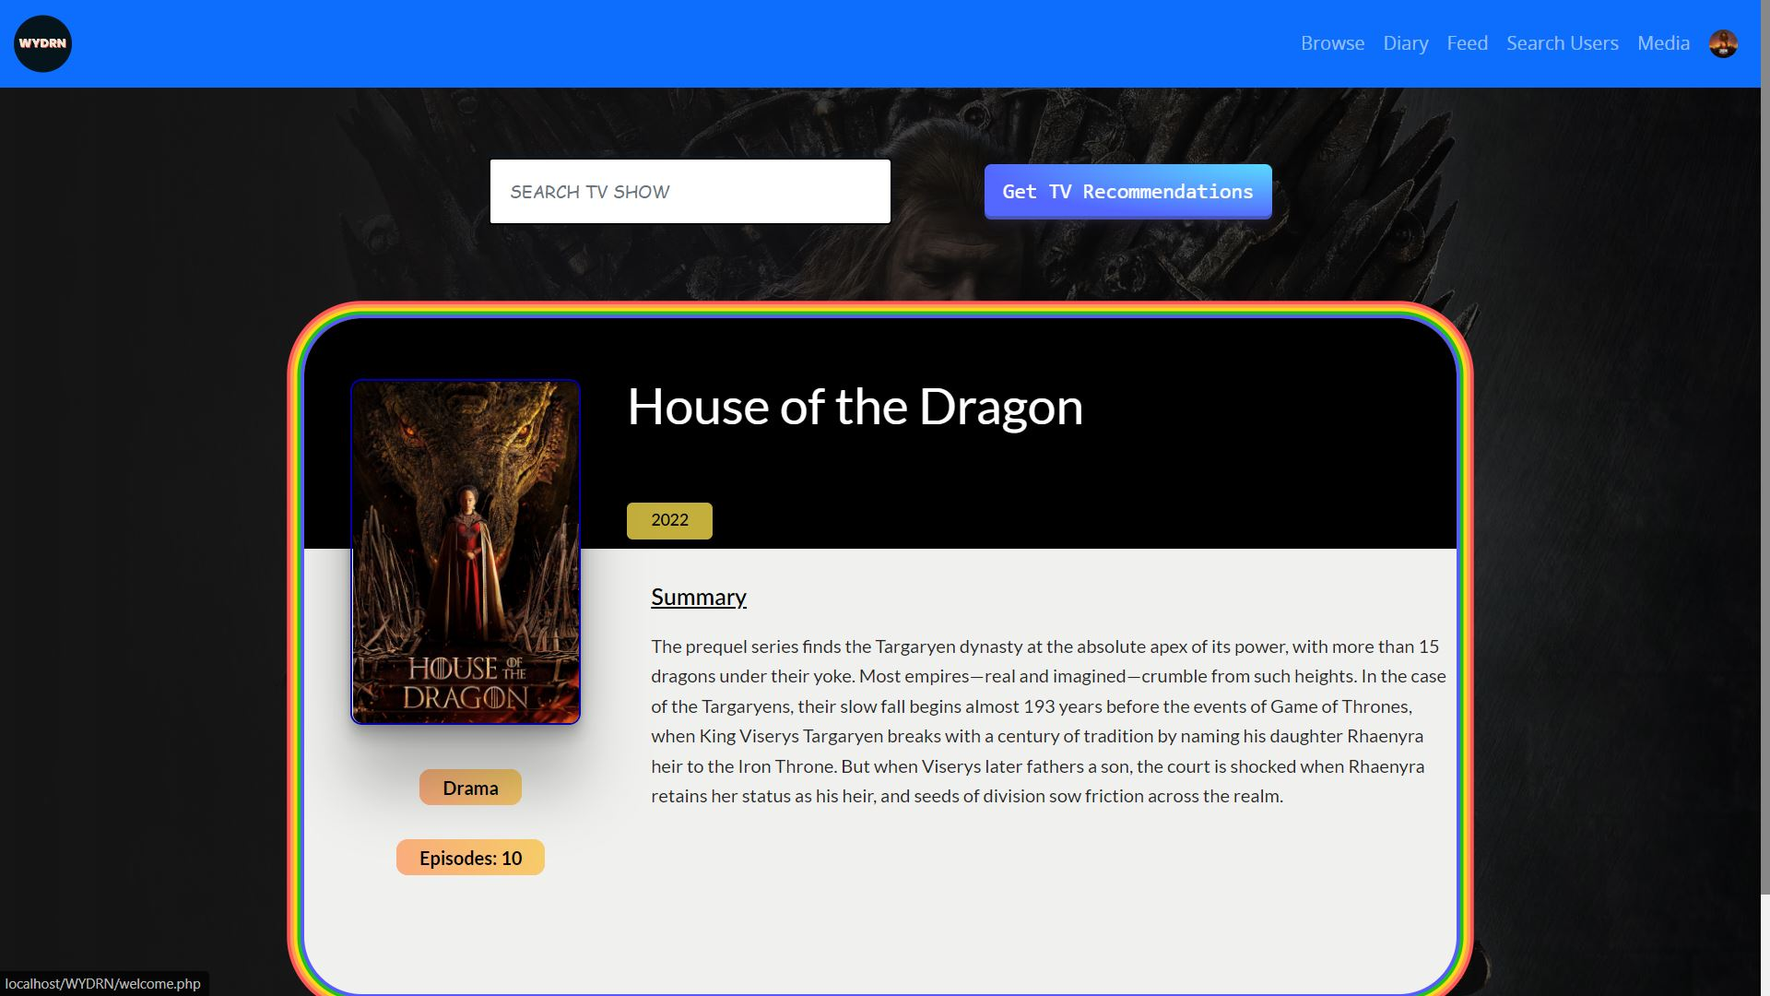
MediaAPIs/TV/index.php

Slide 75
DETAILS HERE
This page is used to find information for any tv-show searched by the user.
The page makes use of the TMDB(Television and Movie Database) API.

Slide 76
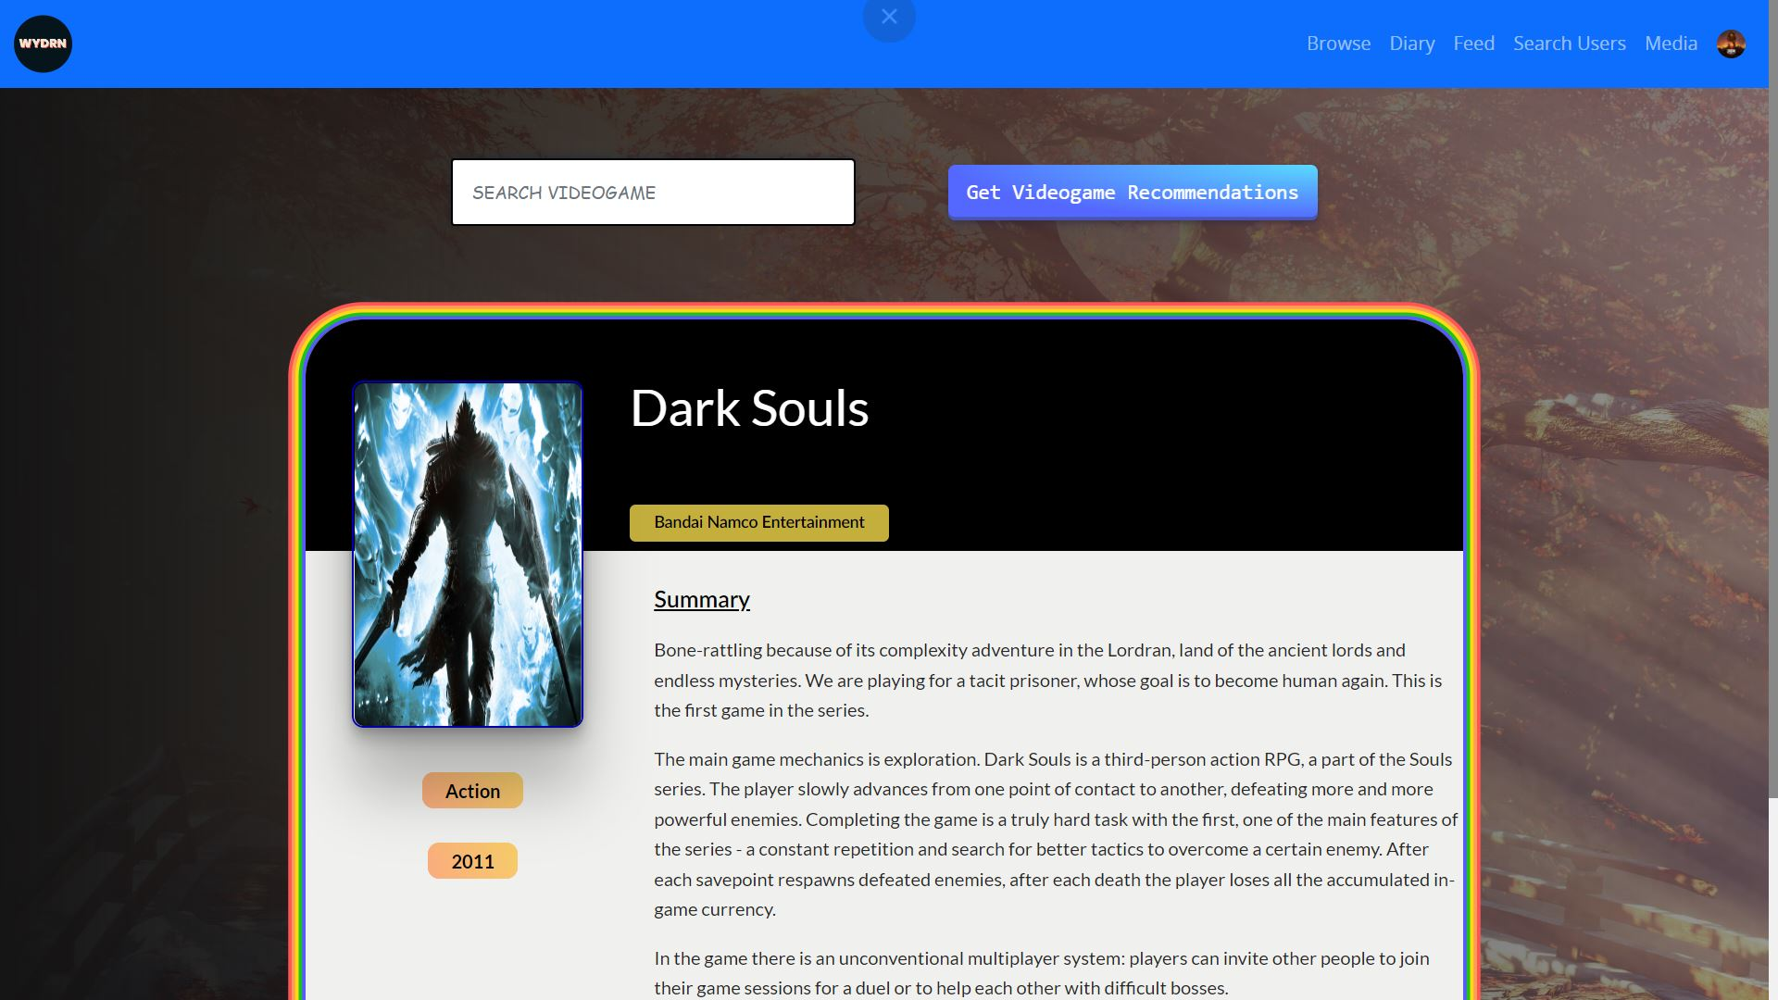
MediaAPIs/Vidoegames/index.php

Slide 77
DETAILS HERE
This page is used to find information for any videogame searched by the user.
The page makes us of the RAWG API.

Slide 78
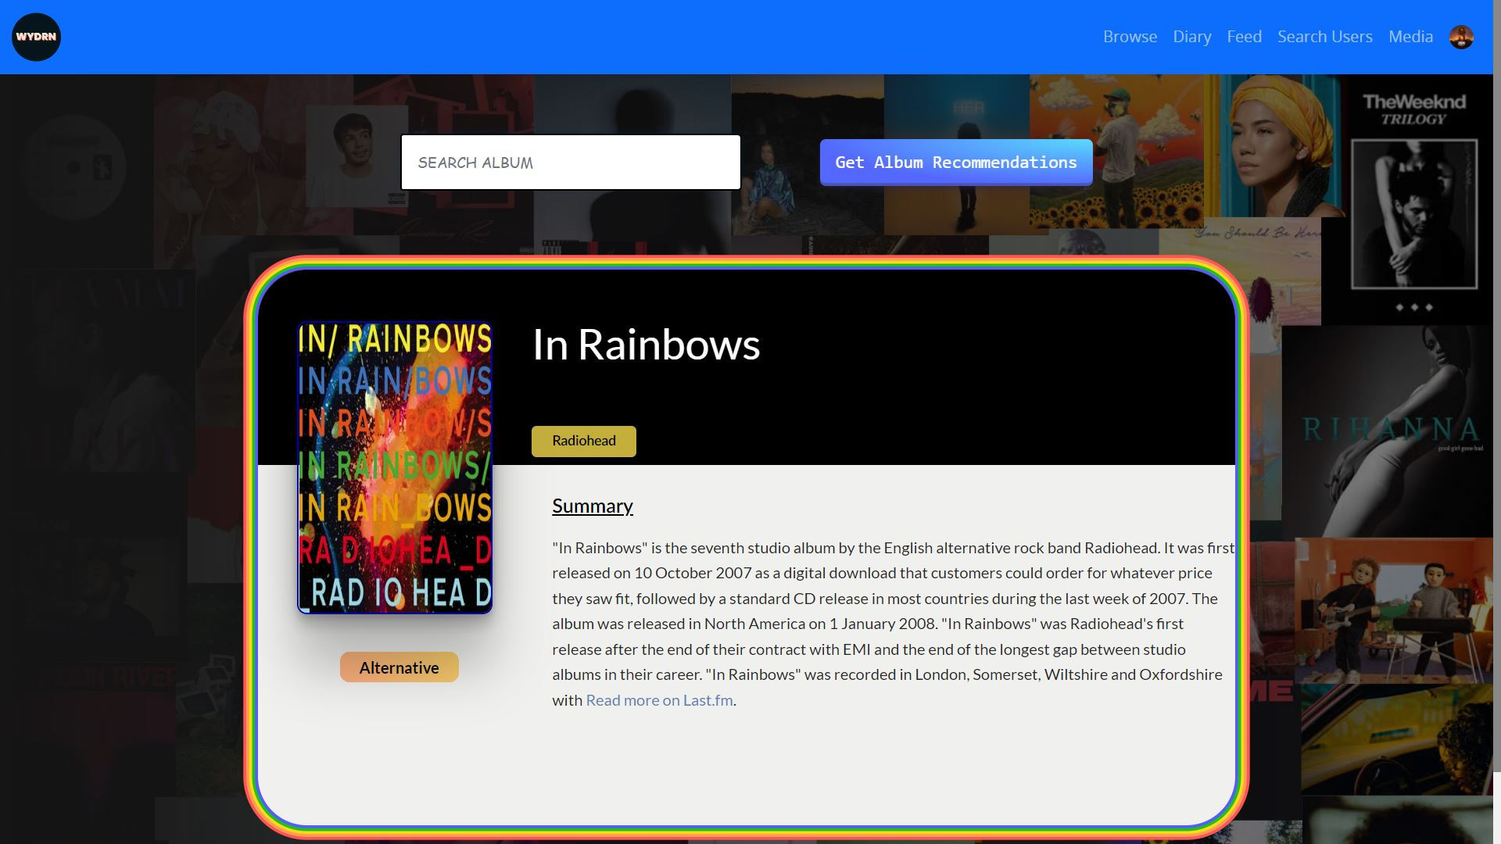
MediaAPIs/Album/index.php

Slide 79
DETAILS HERE
This page is used to find information for any album/music searched by the user.
The page makes use of the Last.FM API.

Slide 80
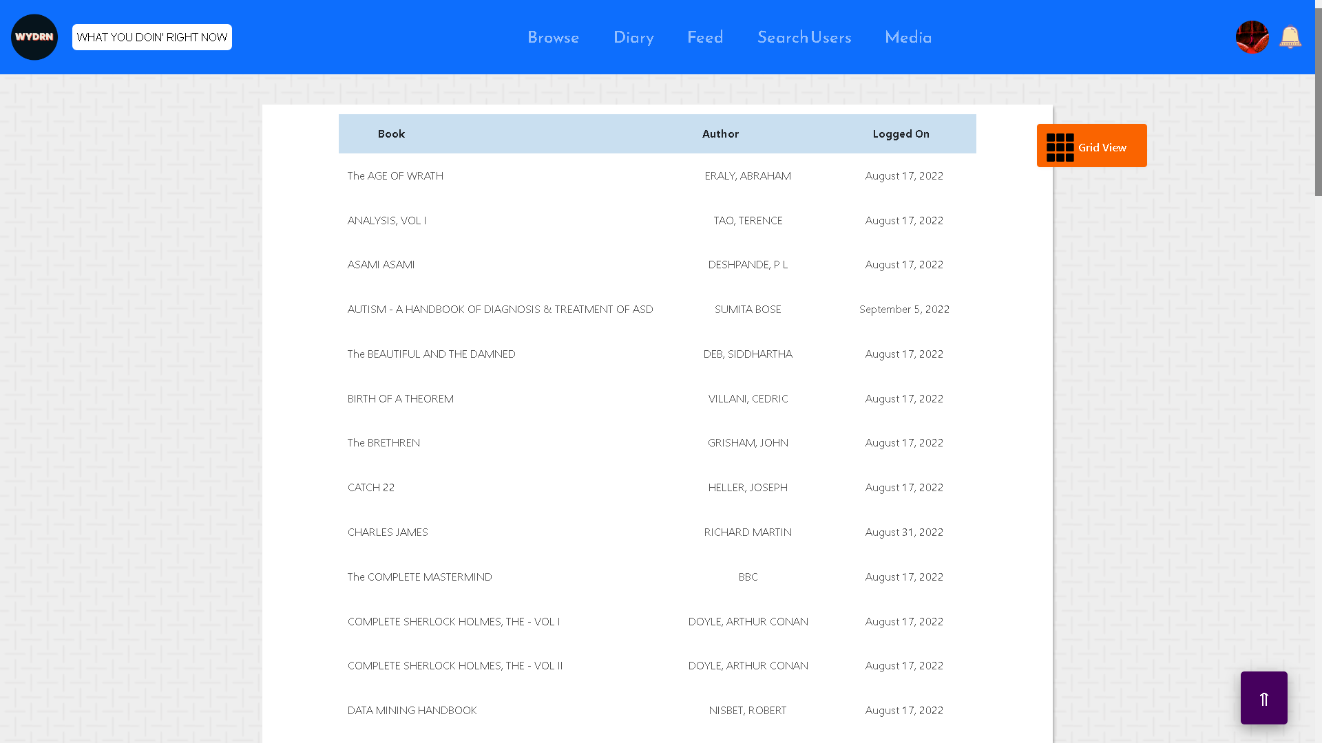
media_list_view.php

Slide 81
DETAILS HERE

Slide 82
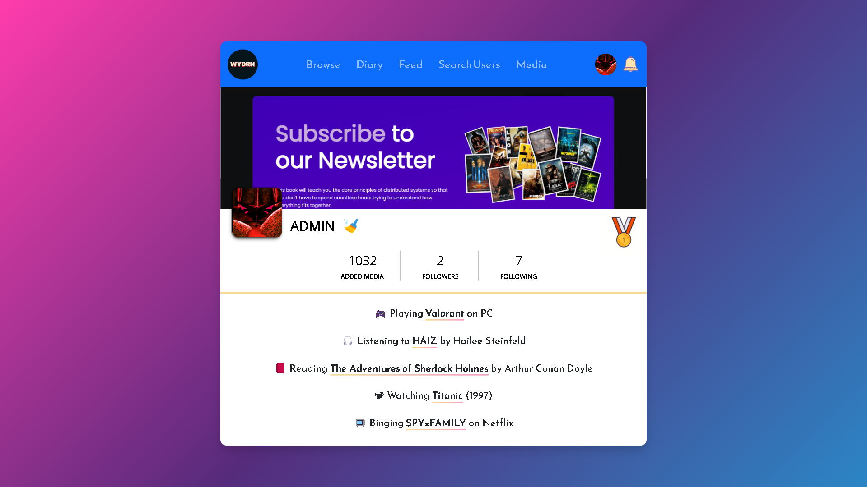
profile.php

Slide 83
The main profile page of the user. The most important page to this project.
checks if user has logged in and grabs the username from the database. If the username is mentioned in the url address, the username is grabbed using a "Get" request and the user data corresponding to the username is grabbed from the database. (may be the same user or may be a public profile url of another user)
this file requires the dependency - wydrn.php
DETAILS HERE

Slide 84
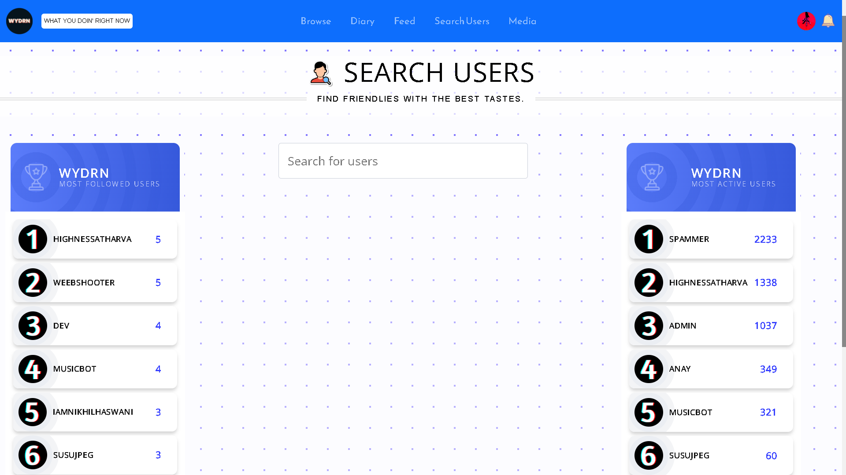
Search_users.php

Slide 85
DETAILS HERE
From this page user can search other users to follow and connect with.
The page uses POST request method to send the data from the user input to the server.
The results are fetched from the 'users' table and displayed.
This page displays the top 10 most followed users in a column on the left.
It also displays the most active users on the website ,by sorting them on the basis of their number of media entries

Slide 86
WYDRN.php
DETAILS HERE

Slide 87
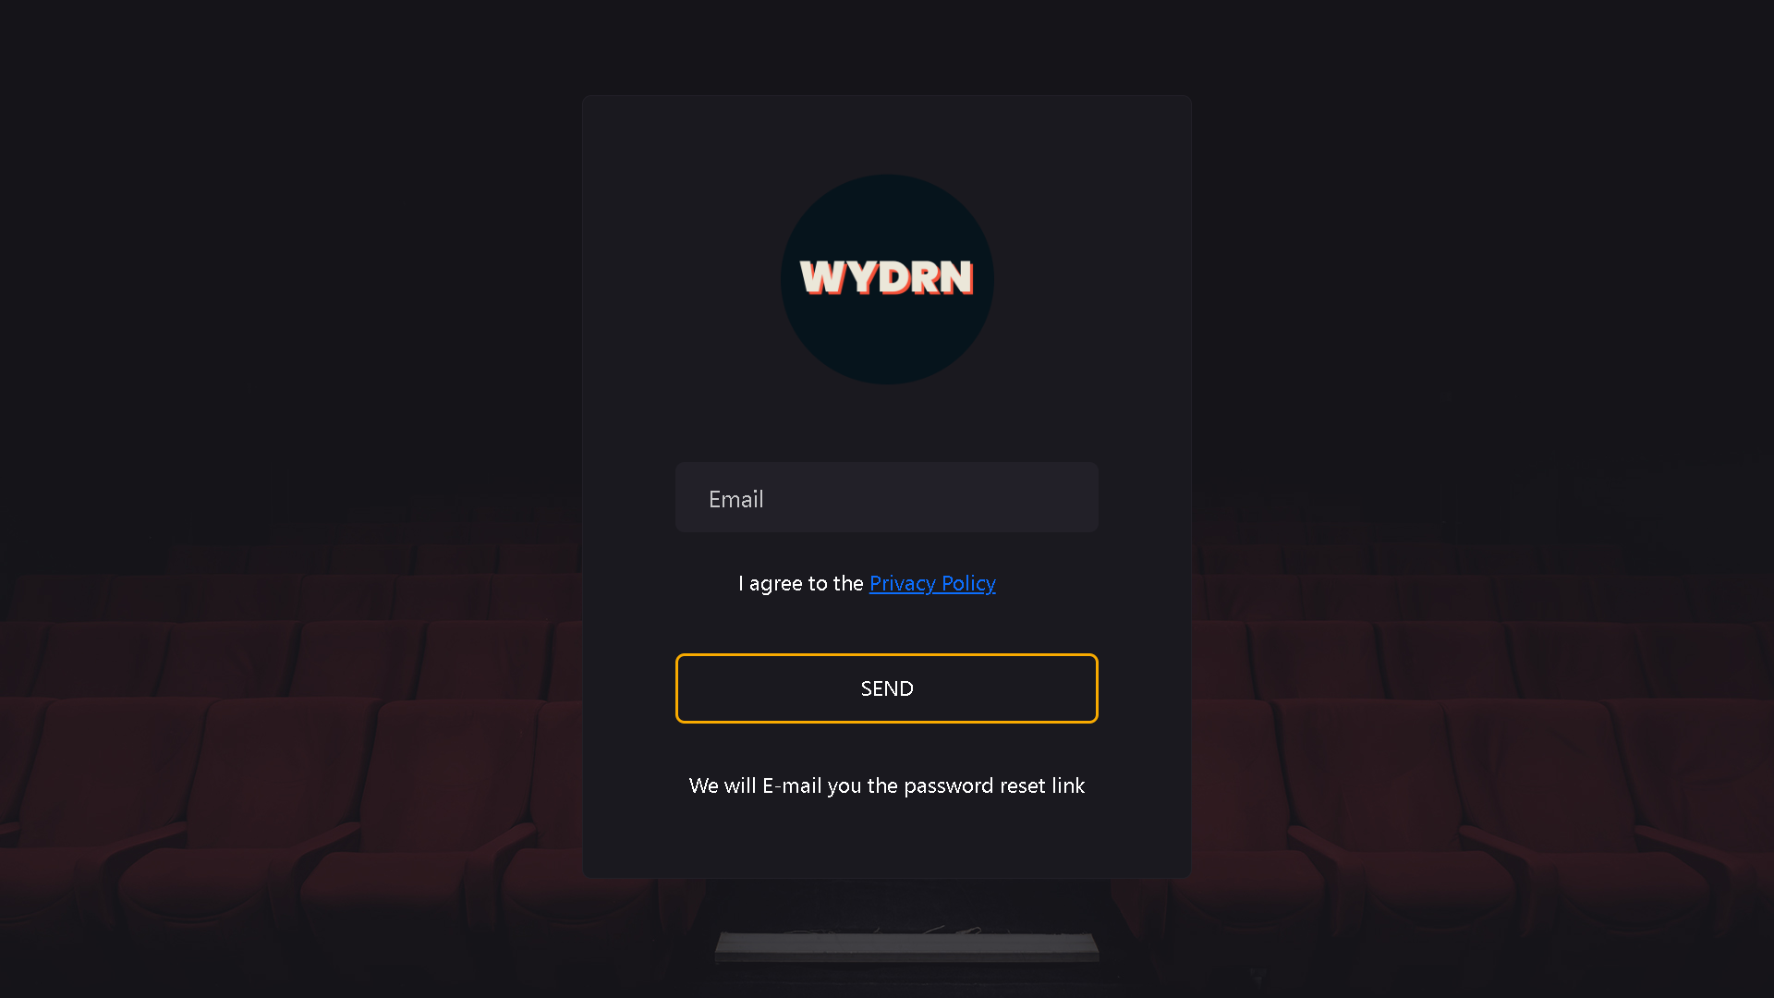
send_reset_link.php

Slide 88
Displays Single Input Field asking user to enter an Email to Recieve the Password Link On.
On Form Submission It checks if the Email Entered is Registered with WYDRN Service and pushes an email if yes.
DETAILS HERE

Slide 89
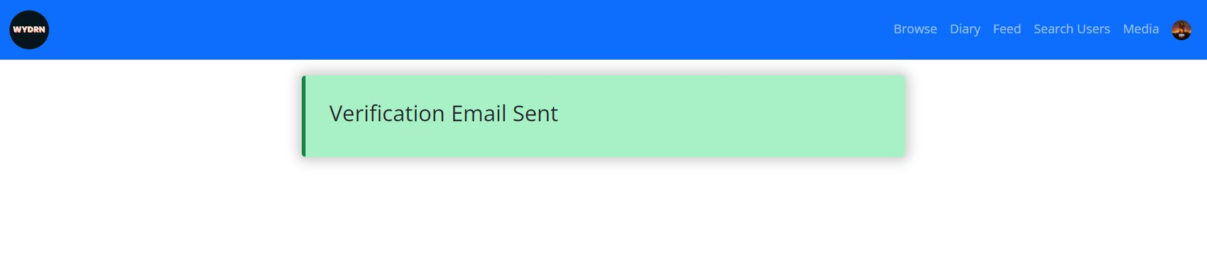
verify.php

Slide 90
DETAILS HERE
Calls the mailer_verify_email() function and uses the SMTP protocol to send an email to the associated email of the logged in user.
Upon clicking the link, user will land on the same page but it will have a GET request with the “link” parameter attached to it which will have the md5() value of the username since it is unique.
If an invalid or hoax link is presented an error alert is thrown.
When a valid GET request with the link parameter is made, the value 1 is inserted into the verified column of the users table meaning that the user account is now successfully verified.
Bootstrap classes along with custom CSS to design the success and the error messages.

Slide 91
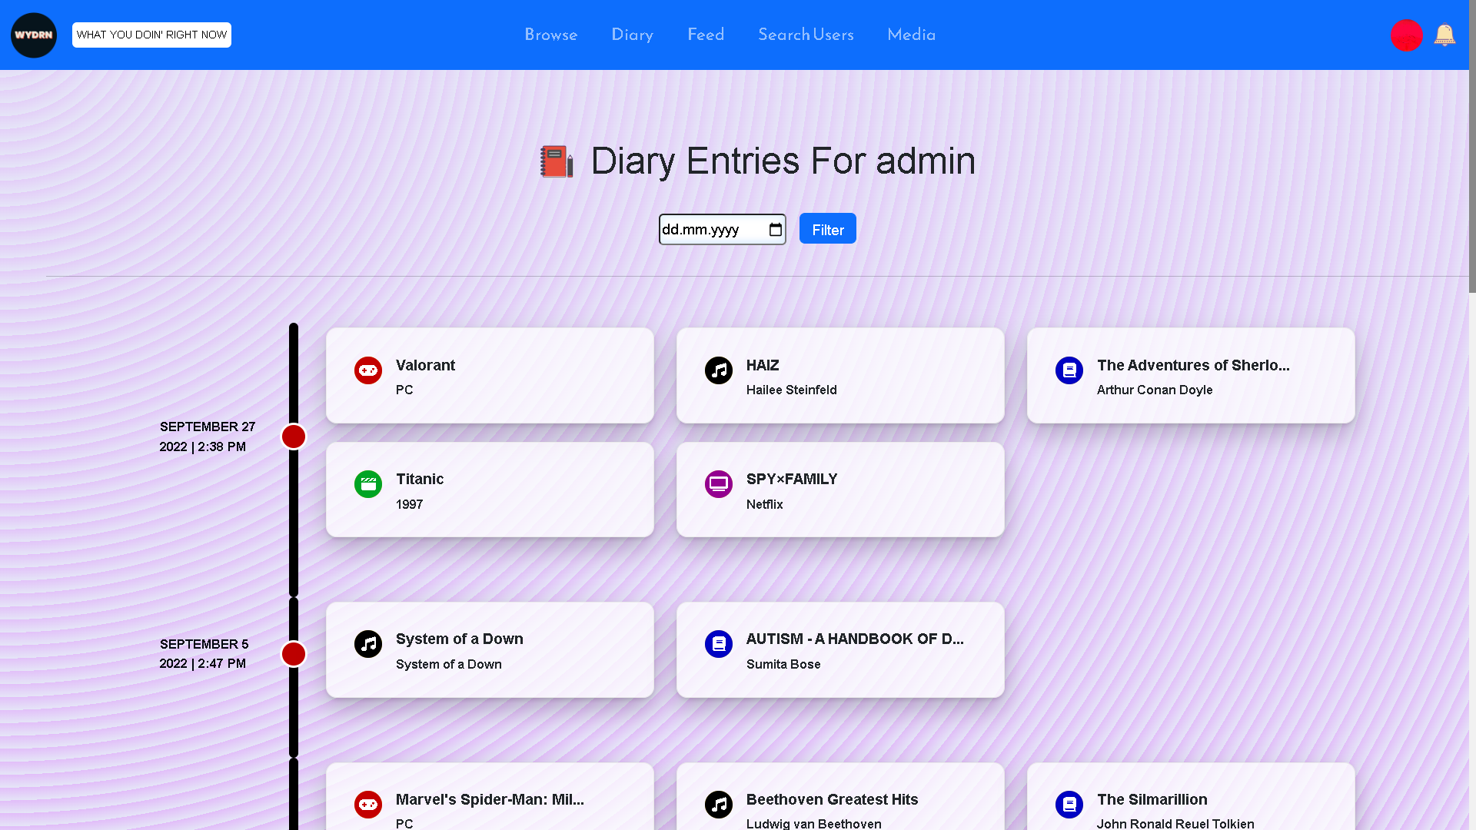
diary.php

Slide 92
DETAILS HERE
The diary page show users a log of entries on WYDRN.
Order in which the entries are shown is of most recent to last recent grouped by date.
The data is shown in a tabular manner.
This page also provides a convenience to the user by allowing them to filter the entries on the basis of their desired dates.
The page uses POST request method to send the data from the user input to the server.
After selecting a date and clicking on the "Filter by date" button user can easily access the entries of the selected date.
The data displayed is fetched from the table 'data' in the database.
Each page has a limit of displaying 10 entries only.
Pagination is also added at the bottom of the page using grid container, in order to show the pagination row and manual input box next to each other.

Slide 93
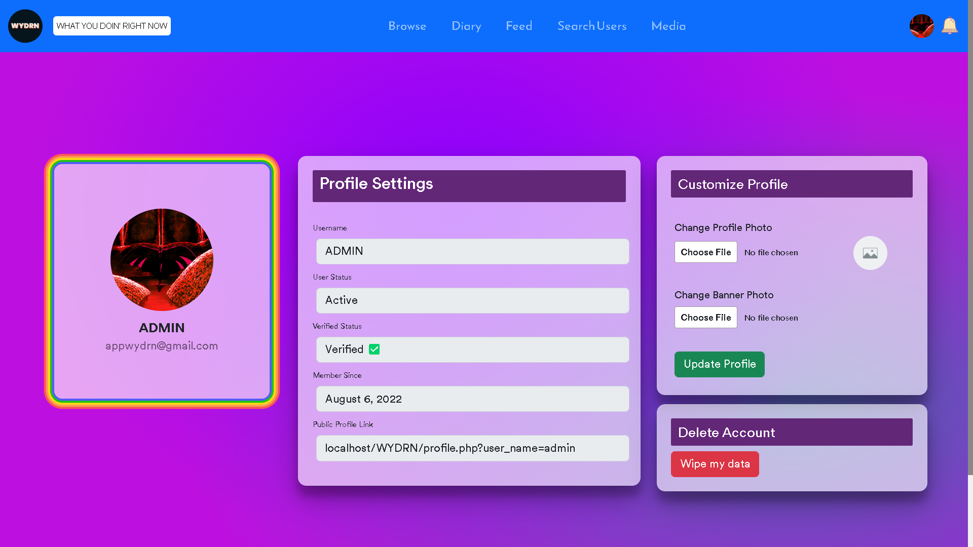
edit_profile.php

Slide 94
DETAILS HERE
User from this page can change/update profile picture and background banner.
The page uses POST request method to send the data from the user input to the server.
Accepted File formats are ".png, .jpg, .jpeg, image/png, image/jpg, image/jpeg, .gif".
Maximum size is 1MB for profile picture and the background banner.
User can click on "Update profile " button to update the selected file as a profile photo or background banner.
"move_uploaded_file" function is used to move the profile picture into database, also "unlink()" function is used to delete the previous file from the database automatically.

Slide 95
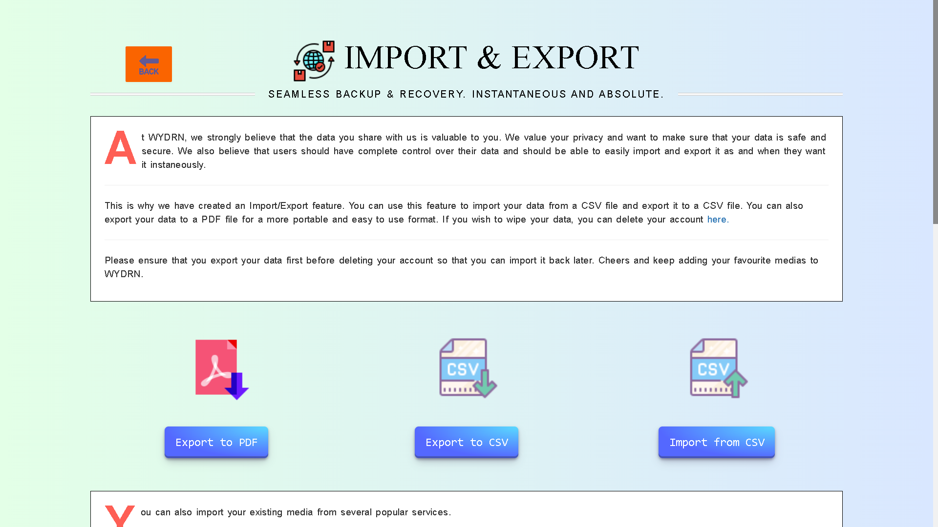

import_export.php

Slide 96
This page allows user to import/export data in csv and export as csv as well as a pdf.
There are 3 separate buttons:
To import a csv
To export a csv
To export a pdf.
This page allows user to import/export data in csv and export as csv as well as a pdf.
There are 3 separate buttons:
To import a csv
To export a csv
To export a pdf.
DETAILS HERE
This page allows user to import/export data in csv and export as csv as well as a pdf.
There are 3 separate buttons:
To import a csv
To export a csv
To export a pdf.
Services used that allows user to import specific media's are:
a. Goodreads for importing books
b. RYM(rate your music) for importing music albums
c. IMDB/Letterboxd for importing movies
d. Trakt for importing TV shows
e. Steam for importing video games

Slide 97

exports/pdf.php

Slide 98
DETAILS HERE
This file performs only backend functions and does not include any markup.
Utility Export tool allowing the user to export the data to pdf in tabular format along with datetime and recorded activity from the database. The user must be logged in to do so.

Slide 99


exports/csv_export.php

Slide 100
DETAILS HERE
Allow user to import data from exported csv. Data is processed and stored in the database. The user must be logged in to do so.

Slide 101

exports/csv_import.php

Slide 102
DETAILS HERE
Missing Content

Slide 103
Exports/download_csv.php
DETAILS HERE

Slide 104

stats.php

Slide 105
DETAILS HERE
Show stats of a user such as bifurcation of activities, number of activities, weekly and yearly logged items etc.

Slide 106


admin.php

Slide 107
DETAILS HERE

Slide 108

RecommendationML/index.php?movie

Slide 109
DETAILS HERE

Slide 110

RecommendationML/index.php?book

Slide 111
DETAILS HERE

Slide 112

RecommendationML/index.php?tv

Slide 113
DETAILS HERE

Slide 114

RecommendationML/index.php?music

Slide 115
DETAILS HERE

Slide 116

RecommendationML/index.php?videogame

Slide 117
DETAILS HERE

Slide 118

About/index.html

Slide 119
DETAILS HERE

Slide 120

privacy_policy.php

Slide 121
DETAILS HERE
Privacy policy page for the users to let them know the the data collected by our site and the rights we hold over the data. Visible from the landing page and while viewing the forgot password page.

Slide 122

ErrorPages/404.html

Slide 123
404 Redirect Page when user lands on a non-existent page.
Page gives an option to the user to redirect on the home page.
DETAILS HERE

